Slide 1
Heart of the community: village halls Conference
Going green amidst an energy crisis Session
Local Energy Scotland - Let’s Do Net Zero Community Buildings Fund
Verena Aedo & Rachel Yule
CARES Development Officers
Notes:
introduction to what LES is
overview of the current let’s do net zero community buildings fund and case studies

Slide 2





The Scottish Government’s
Community and Energy Renewables Scheme (CARES)
delivered by
Local Energy Scotland
Local Energy Scotland is a consortium comprising:

Slide 3
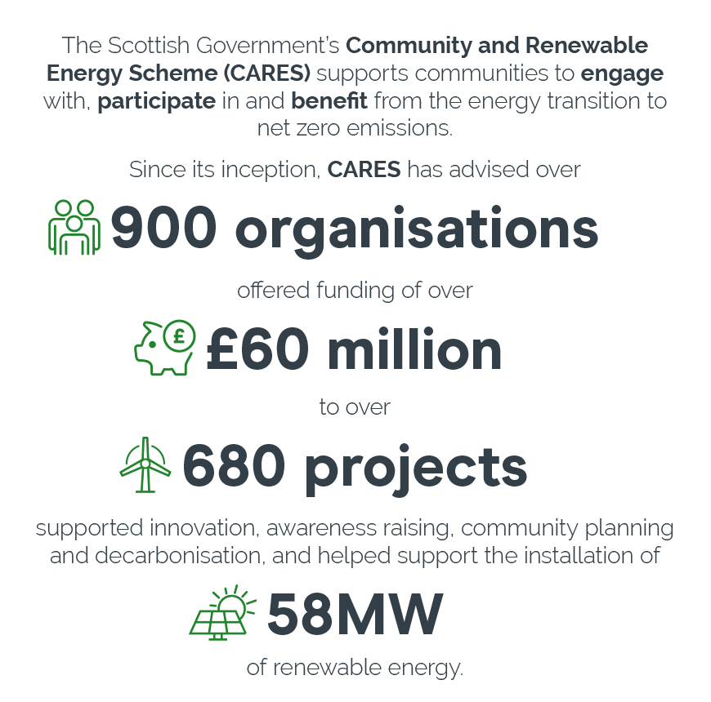
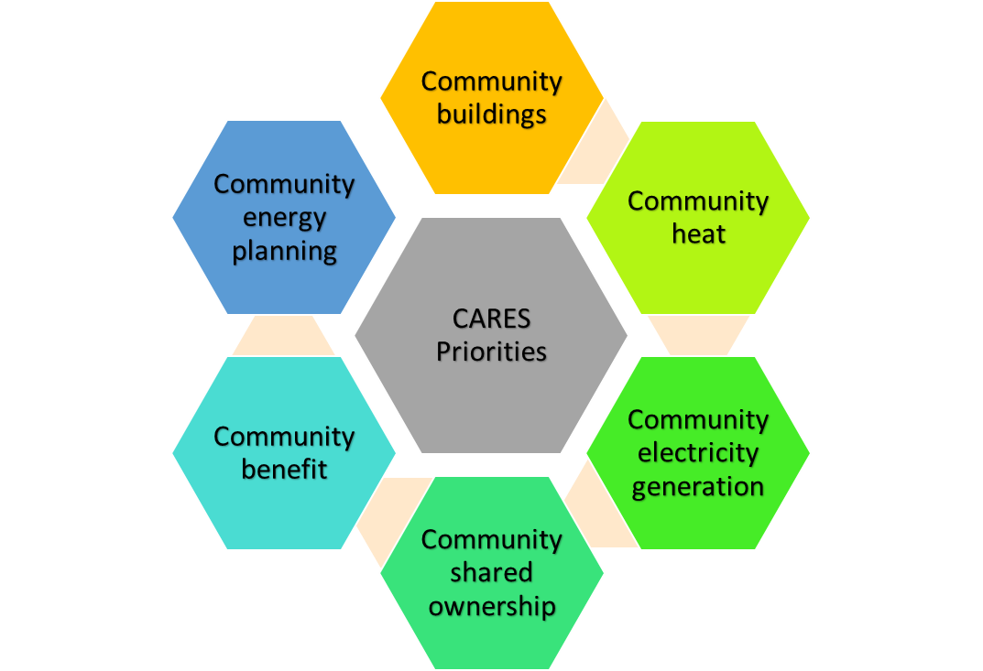

Slide 4

CARES - Let’s Do Net Zero Community Buildings Fund
Decarbonise community, charity and faith buildings.
Heat, renewables and energy efficiency.
80% of eligible costs up to a maximum of £80,000 per site.
Subject to availability, first-come, first-served basis
Fund will pause on 31 March 2025
Following approval, all work related to this funding must be completed and funding claimed within 12 months or by 31 March 2025, whichever is sooner.
Prioritise getting a quote
Development officer & technical support
Notes:
The focus of this funding is decarbonising the heating system in community Bs
Timescales
The Community Buildings Fund will pause on 31 March 2025
Once approved for funding, all work related to this funding must be completed and funding claimed within 12 months or by 31 March 2025, whichever is sooner.
Extensions can be requested, and these are likely to be approved where projects can evidence significant progress, however we will not be able to approve extensions beyond 31 March 2025.
Extensions are likely to be rejected where sufficient progress is not demonstrated and/or where monthly progress reports have not been completed, to ensure that CARES funding is available for other projects where progress can be made.
Funding is limited and successful applicants will be allocated funding on a first-come, first-served basis.
Please note your funding isn’t allocated to you until you have submitted a full application and have received a grant offer letter.
To be approved you will need to submit a quotation showing an installation date from your preferred supplier – please prioritise getting a quote and see our guidance on requesting quotations from installers.

Slide 5
Low Carbon Spaces – Let’s Do Net Zero Community Buildings Fund
See the Alford & District Men’s Shed video on our YouTube channel:
https://www.youtube.com/watch?v=a-4600gZGFg
CARES funding package
  Capital grant (renewable and energy efficiency measures and project development costs).
  Technical support on some occasions.
Alford & District Men’s Shed, Aberdeenshire
Notes:
Thermal Storage Tank and Battery System for ADMS
Grant offered: £99,695.00
Activities: A2A, options appraisal, Solar PV, Battery Storage

Slide 6
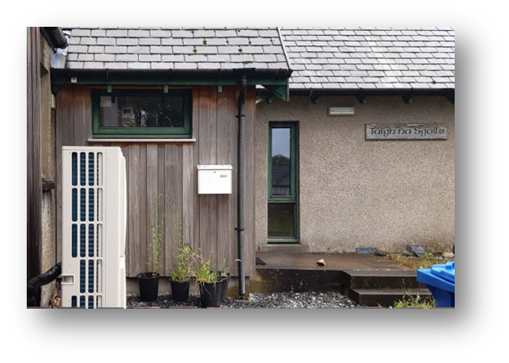

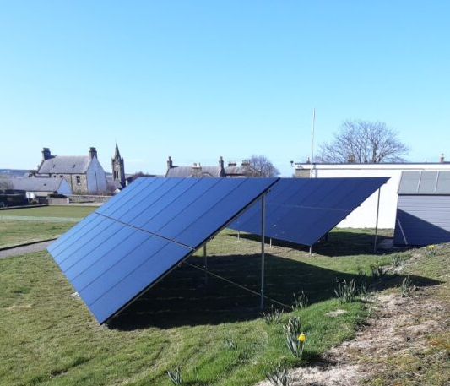
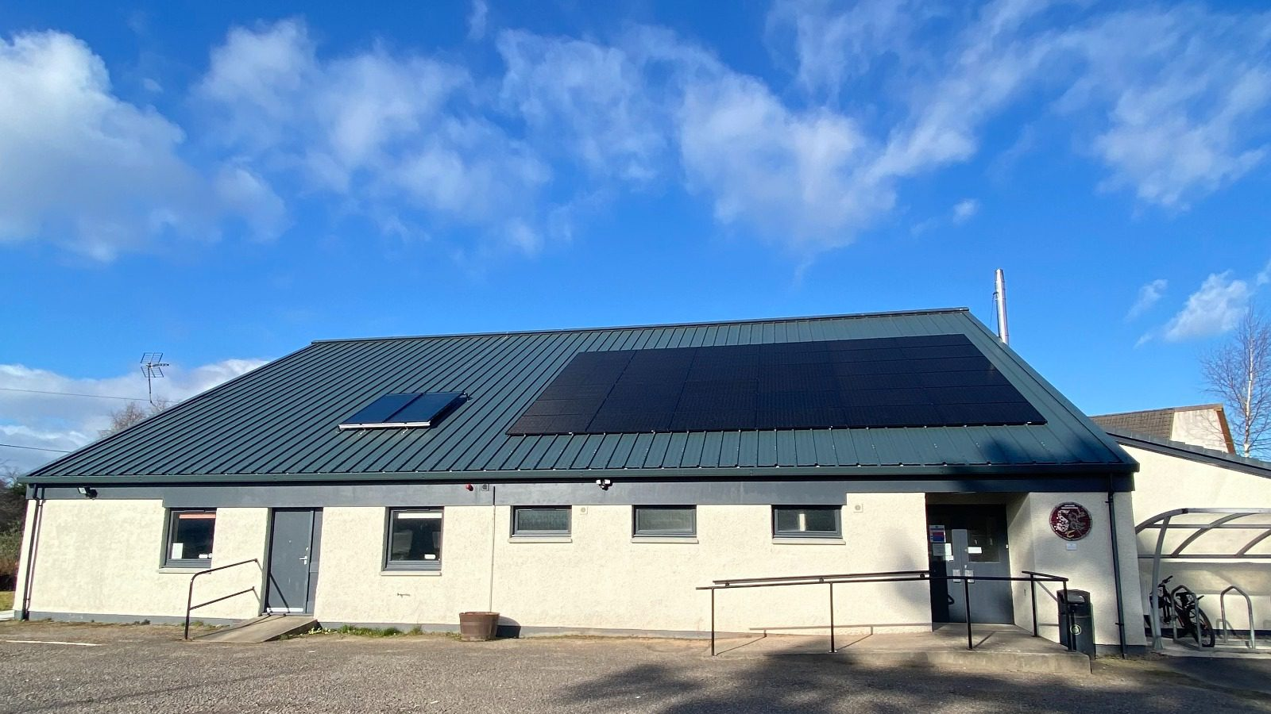
Case studies - Community Buildings Fund
“The Solar Panels have already made a huge difference - our bill was about £1000 a month but now our latest one is down to around £300."
“We would have struggled to continue to operate without the heat pump because our pellet boiler was beyond economic repair and very expensive to run”
Findon Hall
“Users of the centre have commented on how much better it feels throughout and there has been an increase in the number of people using the centre”
Acharacle
Community Centre
Cullen Bowling & Tennis Club
“CARES funding was crucial [..] This will be for the elderly, a warm space, and catering will be partly done by young adults with additional support needs”
Roy Bridge School
Notes:
Findon Hall
Technology: air-to-air heat pump and solar panels
Location: Culbokie, the Black Isle, Highland
CARES funding: £20,669.97 capital grant
Roy Bridge School House
Technology: air source heat pump
Location: Roy Bridge, near Spean Bridge, Highland
CARES funding: £10,890 capital grant
Cullen Bowling and Tennis Club
Location: Cullen, Moray
Technology: Ground mounted PV panels and energy storage (existing electric heating)
CARES funding: £23,270 capital grant

Slide 7



More than funding
Local development officers support
Technical support
Website with resources
Other funding opportunities
Signposting
Think you're eligible? Submit your expression of interest through our new online portal.

Slide 8
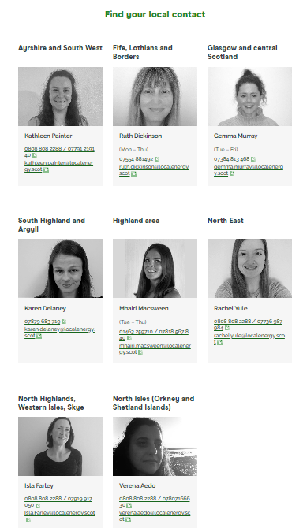
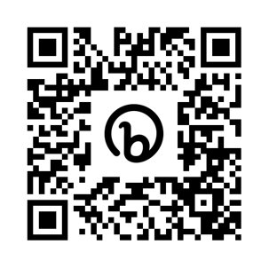


Contact Us
0808 808 2288
Local Energy Scotland, Energy Saving Trust, Third Floor, Prospect House,
5 Thistle Street, Edinburgh, EH2 1DF
localenergy.scot
info@localenergy.scot
@localenergysco
/localenergyscotland
/localenergyscotland

