Slide 1
From Here to Sustainability Programme of enterprise support in Scotland and ideas for Enterprise in Village Halls Douglas Westwater

Slide 2
The Challanges
The community and third sector is changing rapidly.
Funding constraints and public sector funding cuts
Severe restrictions on capital funding
Changing patterns after covid
Cost of Living reducing customer/tenant spend
Cost escalation – utilities etc
Net zero - increase in costs and time
Living wage and fair work – conditionality issues
Wellbeing economy and Community Wealth Building
There is a real need to look at sustainability in a new way.
These programmes exist to help delivery organisations to cope with change and find their own way to reach greater sustainability.

Slide 3
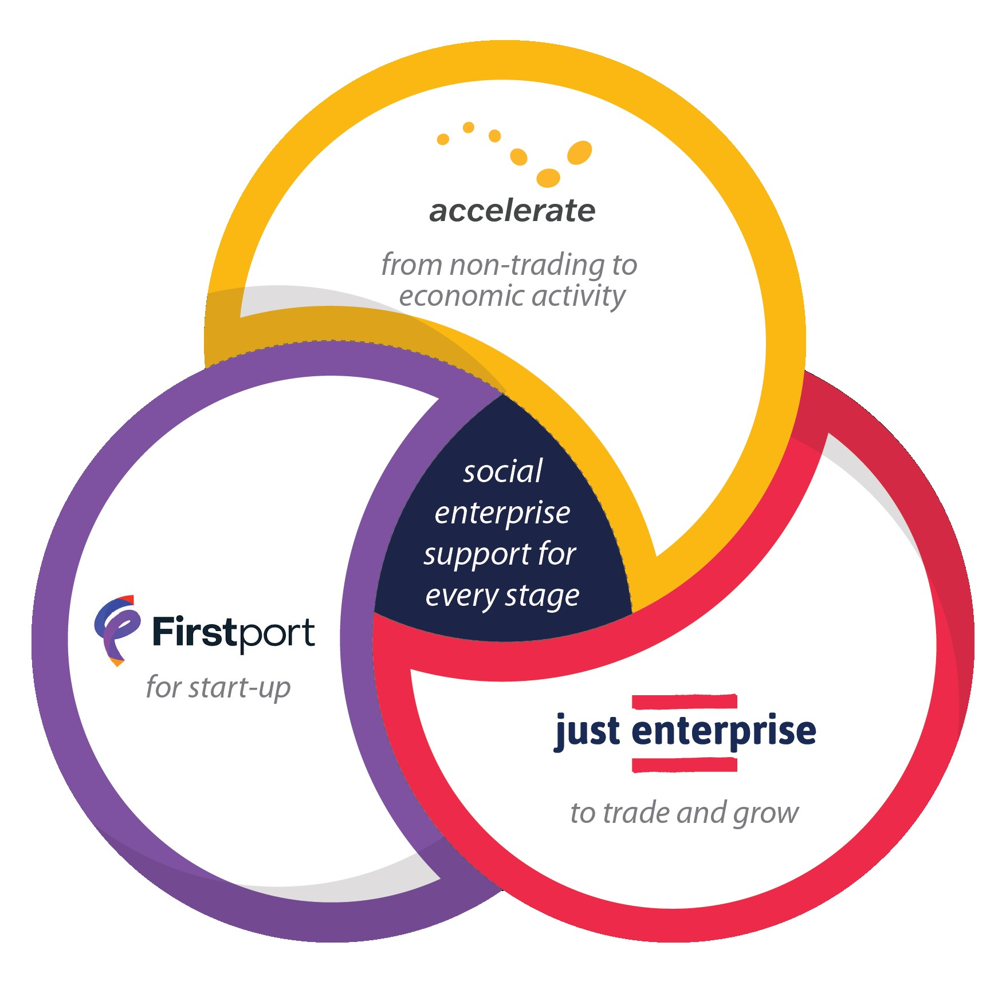
Meeting Different Needs
Accelerate – non trading community groups
Just Enterprise – trading social enterprises
First Port – individual social entrepreneurs

Slide 4
Eligibility
Based in Scotland
Trading
Asset locked social enterprise
Constituted or a social entrepreneurs

Slide 5
Nature of Support
Support
One to one Business Support
Start up for social entrepreneurs
Learning
Bespoke up-skilling
Leadership
Resources
Suite of information
Building a website resource
Business Support for existing enterprises
Training and webinars
Business Recovery / crisis support
Group sessions
Information and signposting

Slide 6
Accessing Support
Register once for multiple support
Referred to support provider if eligible
Action plan
Delivery of support
Evaluation
Can apply again

Slide 7
A programme of free consultancy for non-trading third sector groups

Slide 8
What is Non-Trading?
We view trading largely as selling goods or services to the general public, other organisations or the local community. This will include competitive tendering. Where a group is trading commercially, we would refer them to Just Enterprise.
Low level trading could be things like spring fairs, coffee mornings, donations based film nights. We would not view this as commercial trading. This is quite common in village halls.
We work closely with Just Enterprise and will discuss clients with them to decide where the support should come from.

Slide 9
Services and Offerings
This is not a structured support programme that participants join. It is free, flexible consultancy time to deliver exactly what groups need at the pace they need it.
Some examples of help we’ve provided:
Service Examples
Generating ideas and business planning
Digital solutions
Research and consultation
Funding strategy
Marketing and branding
Governance and legal structure

Slide 10
How does it work?
On-line Enquiry Form
Health check to get to know the organisation
Action plan agreed
Support delivered by CE Average duration - 6 days
Evaluation sent
When ready, refer into other support providers in SE eco-system
Quick Eligibility check
Possible out-source to specialist
Link applicant into local and national networks
Move into long term light touch mentoring/after care

Slide 11
Mentoring and After Care
This is directly related to support to the sustainability or trading idea not general organisational mentoring
We will refer groups into their appropriate network quickly so they can get broader long term support from the appropriate agency (nationally, locally or thematically)
We have estimated mentoring to amount to around 1 day but that is flexible.

Slide 12
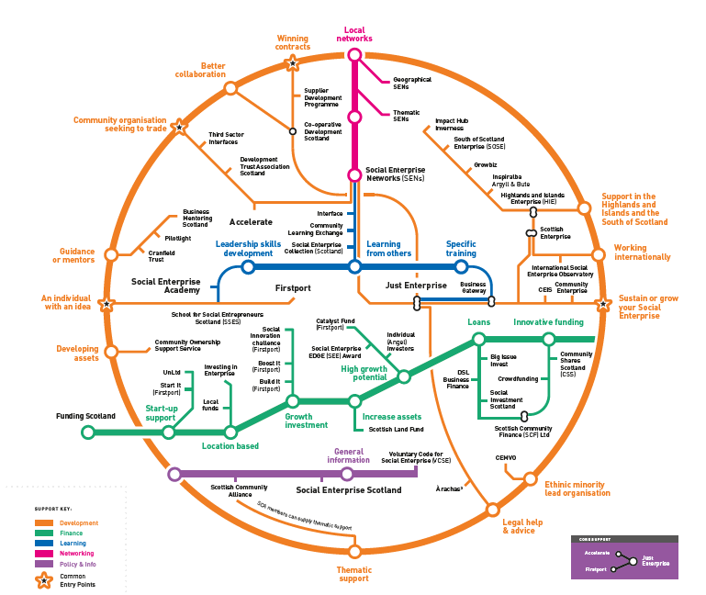

Slide 13
www.sesupportmap.scot

Slide 14
Other Support
Inspiralba
Impact Hub Inverness
Growbiz
HIE
DTAS
Community Learning Exchange

Slide 15
Some ideas
Weddings and corporates
Smart membership and group membership
Develop accommodation – residential retreats (for premium art, heritage, writing etc), artists in residence, bunkhouse
Health, learning and employability contracts
Bespoke Festival Lo
Local craft co-operative
Events in the winter
Café and catering for events
Link to area wide regeneration
Co-working space
Festivals
Childcare
Gym
Soft play

Slide 16
Quick Links
https://sesupportmap.scot/
https://justenterprise.org/business-support-registration/
https://justenterprise.org/start-up-one-to-one-registration/
https://communityenterprise.co.uk/what-we-do/services/accelerate

Slide 17
Questions
douglas@communityenterprise.co.uk / 07989 306374

