Slide 1
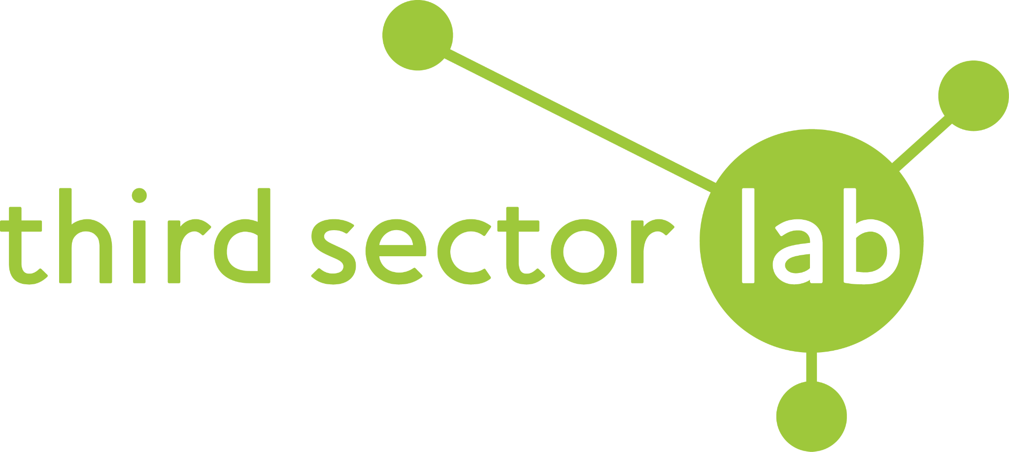
10 Quick Ways to Embed User-Centered Design
Ross McCulloch - Third Sector Lab
Connect on LinkedIn
ross@thirdsectorlab.co.uk
075151 62 686
www.thirdsectorlab.co.uk

Slide 2
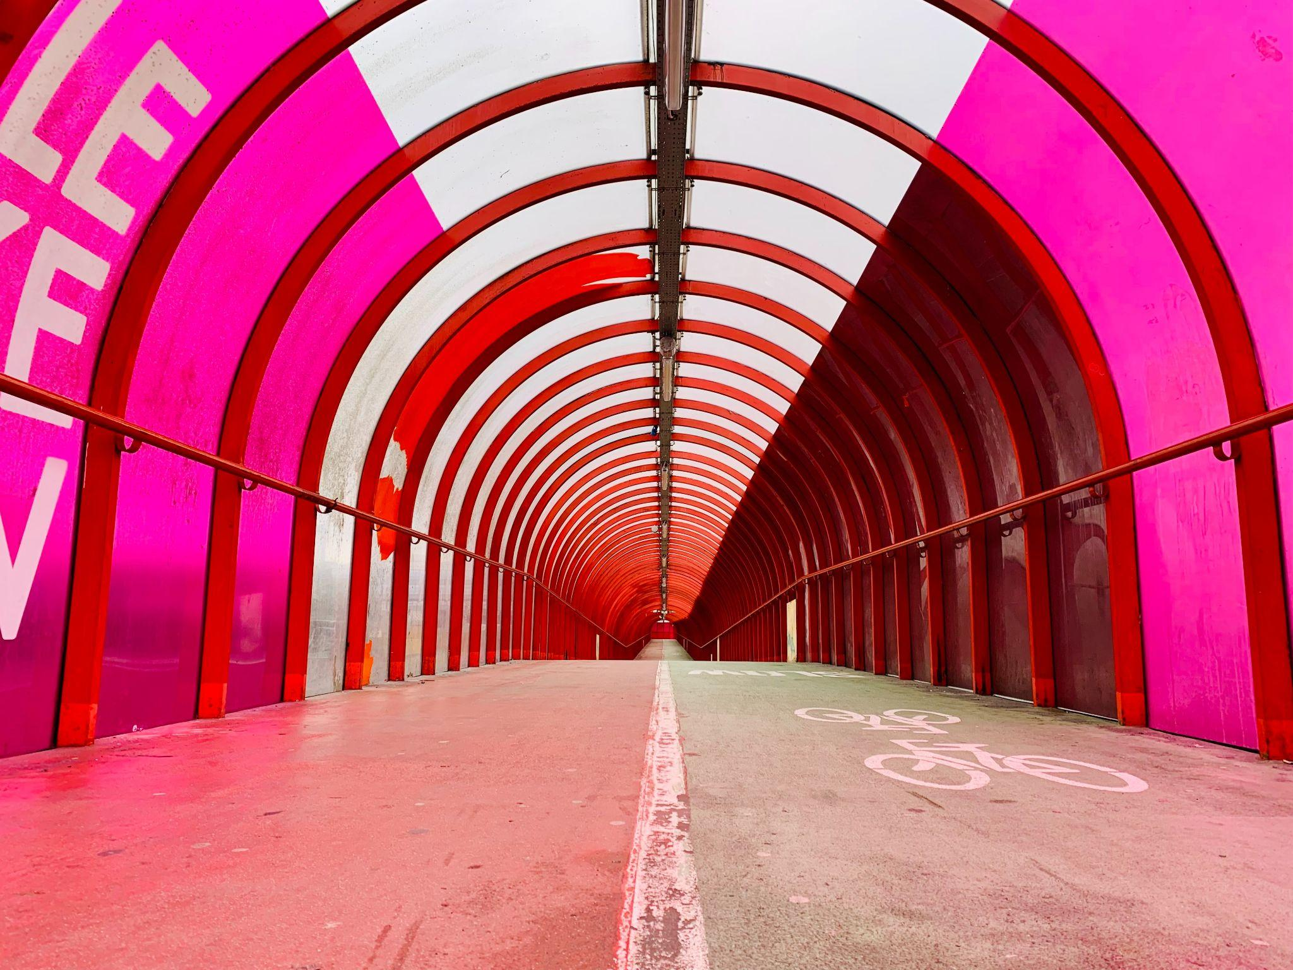
What do we need?
Principles
Process, tools & techniques
Training & talent
Leadership, culture & mindset
Time

Slide 3
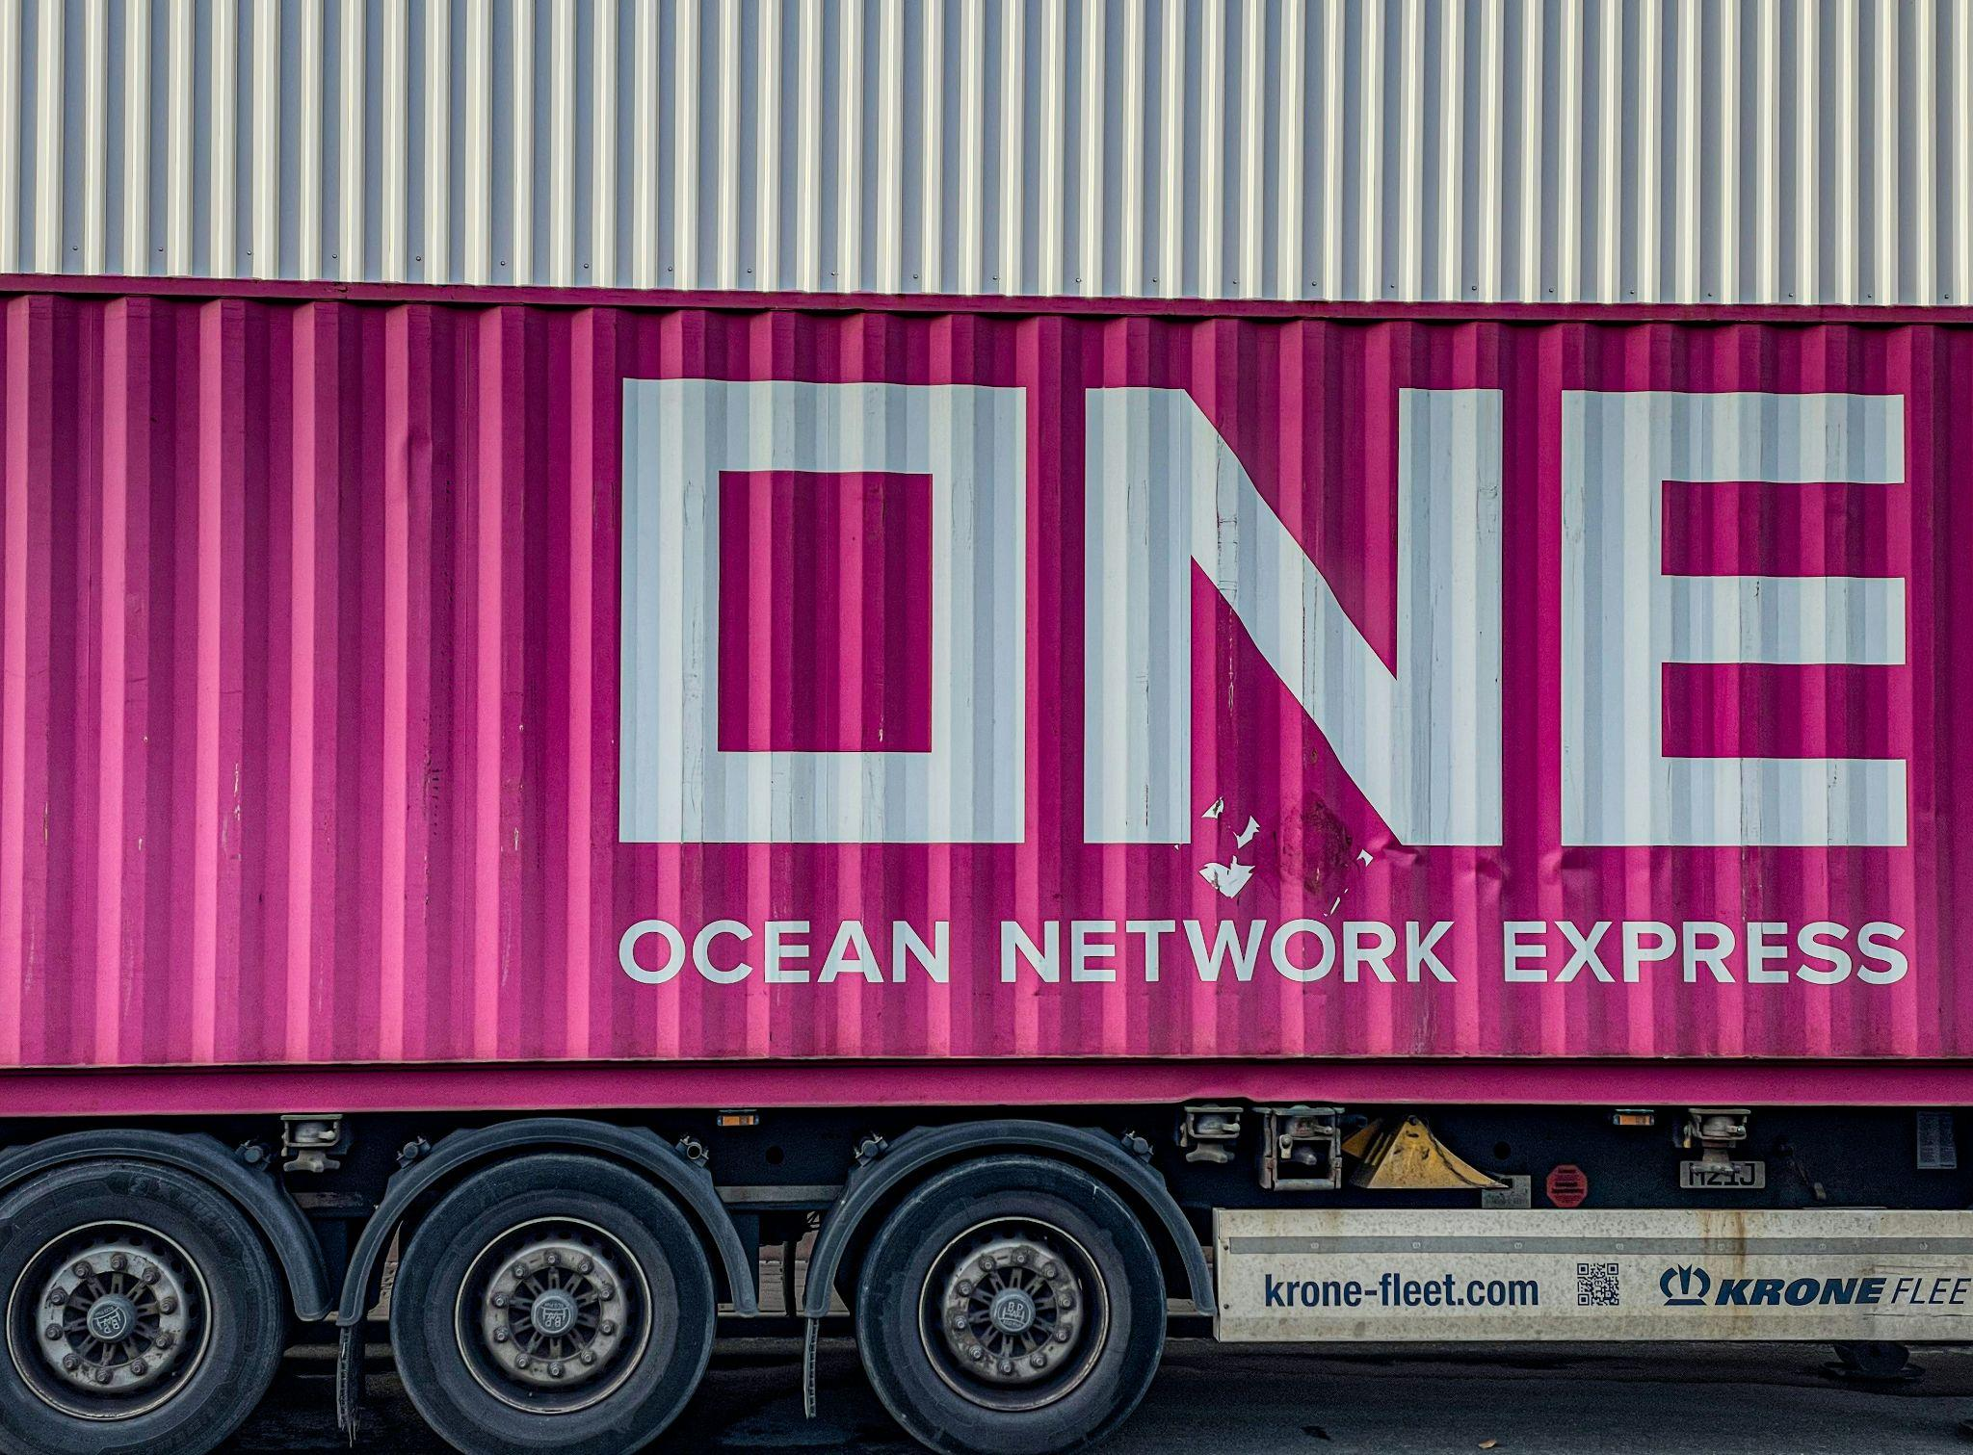
Start with some definitions. Get everyone on the same page.

Slide 4
When we talk about ‘design’ we mean…
“Design is a process, a way of creating services so users can solve a problem, complete tasks and achieve a goal.” Maddie Stark, SCVO

Slide 6
When we talk about ‘digital’ we mean…
“Applying the culture, processes, business models & technologies of the internet era to respond to people’s raised expectations.”
Tom Loosemore, Public Digital

Slide 7
“This is really about service transformation enabled by digital - not digital transformation.”
Sarah Prag
Quotidian Consulting

Slide 8
Actually define your users.

Slide 9
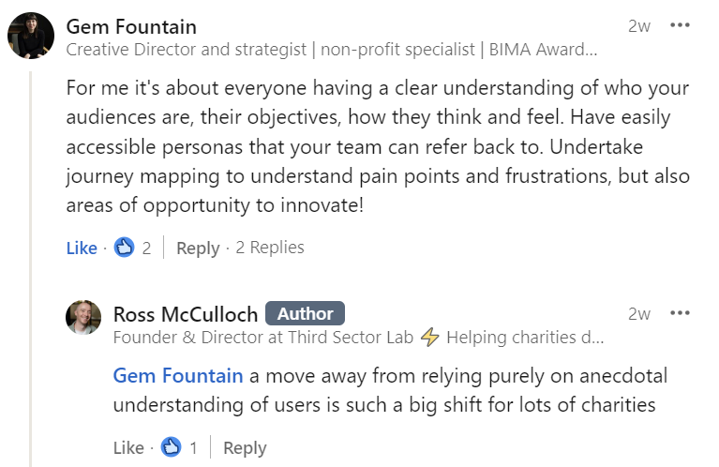

Slide 10
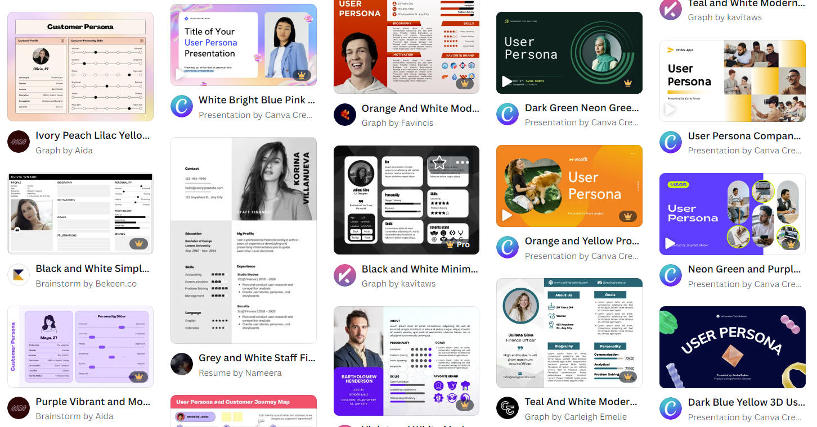
Personas are only useful if you speak to real users.
Service Design Tools - Personas
User needs statements and why charities should use them
Canva persona templates

Slide 11
Do simple user interviews. Good design isn’t just feedback.

Slide 12
A cheat sheet for user interviews and follow up questions

Slide 13
List all your services. External and Internal.

Slide 14
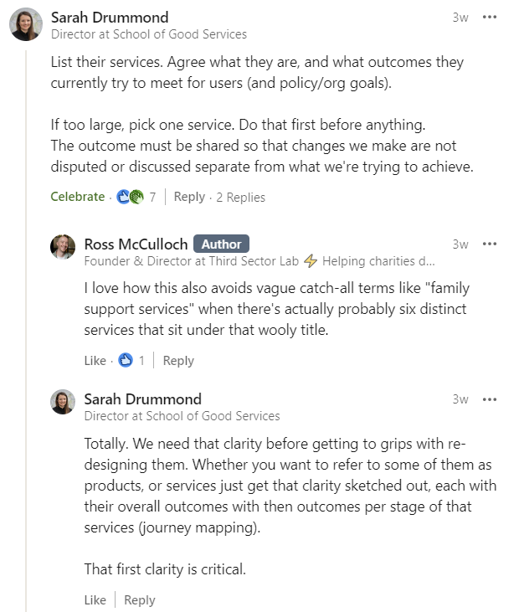

Slide 15
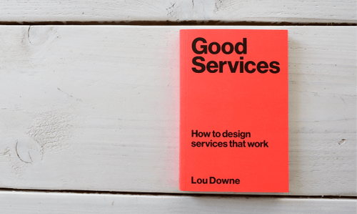
15 Principles of Good Service Design
Free Good Services Scale - Sheets, Excel, PDF, Miro
Choose a service in your organisation.
Pick one principle that service does well. Pick one that needs improvement.

Slide 16
Map out your users’ journeys.

Slide 17
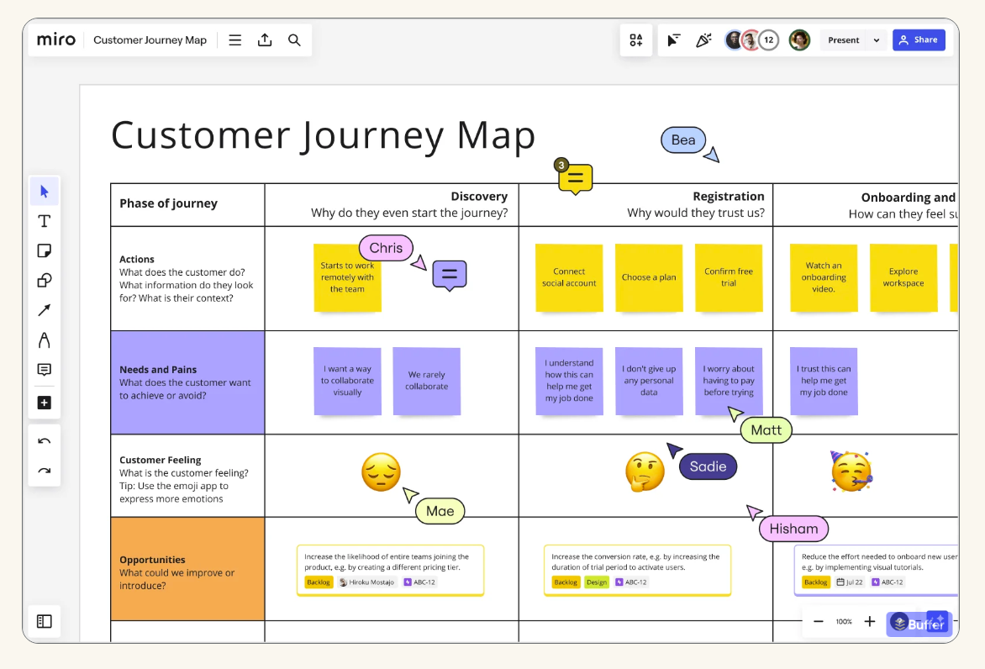
Describe how your user interacts with the service, throughout its touchpoints.
Service Design Tools - Journey Maps
Miro - The 7 steps of the customer journey (plus templates)

Slide 18
Make it relatable. Involve all teams.

Slide 19
Think about a time you experienced amazing service online.
Describe what made that service so good in one word.

Slide 20
“Pick a problem, solve it in as cheap a way as possible, set some sensible metrics and see if it works, if it doesn’t then don’t worry because you haven’t spent much and you’ve probably learnt something quite valuable.
Do it ten times and you’ll wake up to find you’ve built the whole new system for a fraction of the cost.”
Bob Barbour
Previous Head of Digital | Shelter

Slide 21
Do simple user testing. Your website is a great place to start.

Slide 22
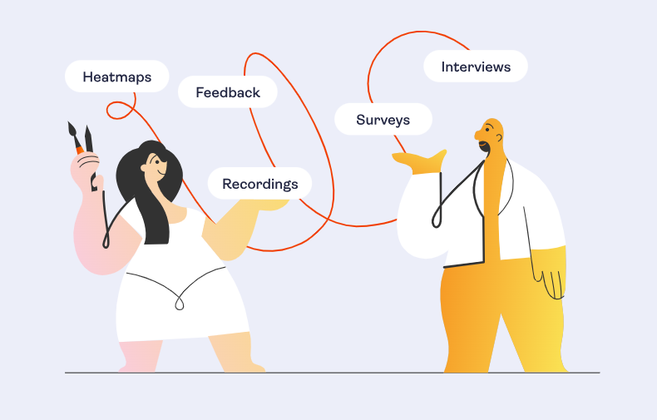
Steve Krug’s guide to lo-fi usability testing that anyone can do
Tools like HotJar and TruConversion give you ongoing user insights

Slide 23
Build meaningful co-design into your next funding bid.

Slide 24
“It is a tool for discovery and exploring opportunities rather than producing final solutions. It aims to start discussion among stakeholders and guide design decisions, for example by building concepts, which informs what should be designed and for whom” - Gyngy Ifekete
How to run a co-design session

Slide 25
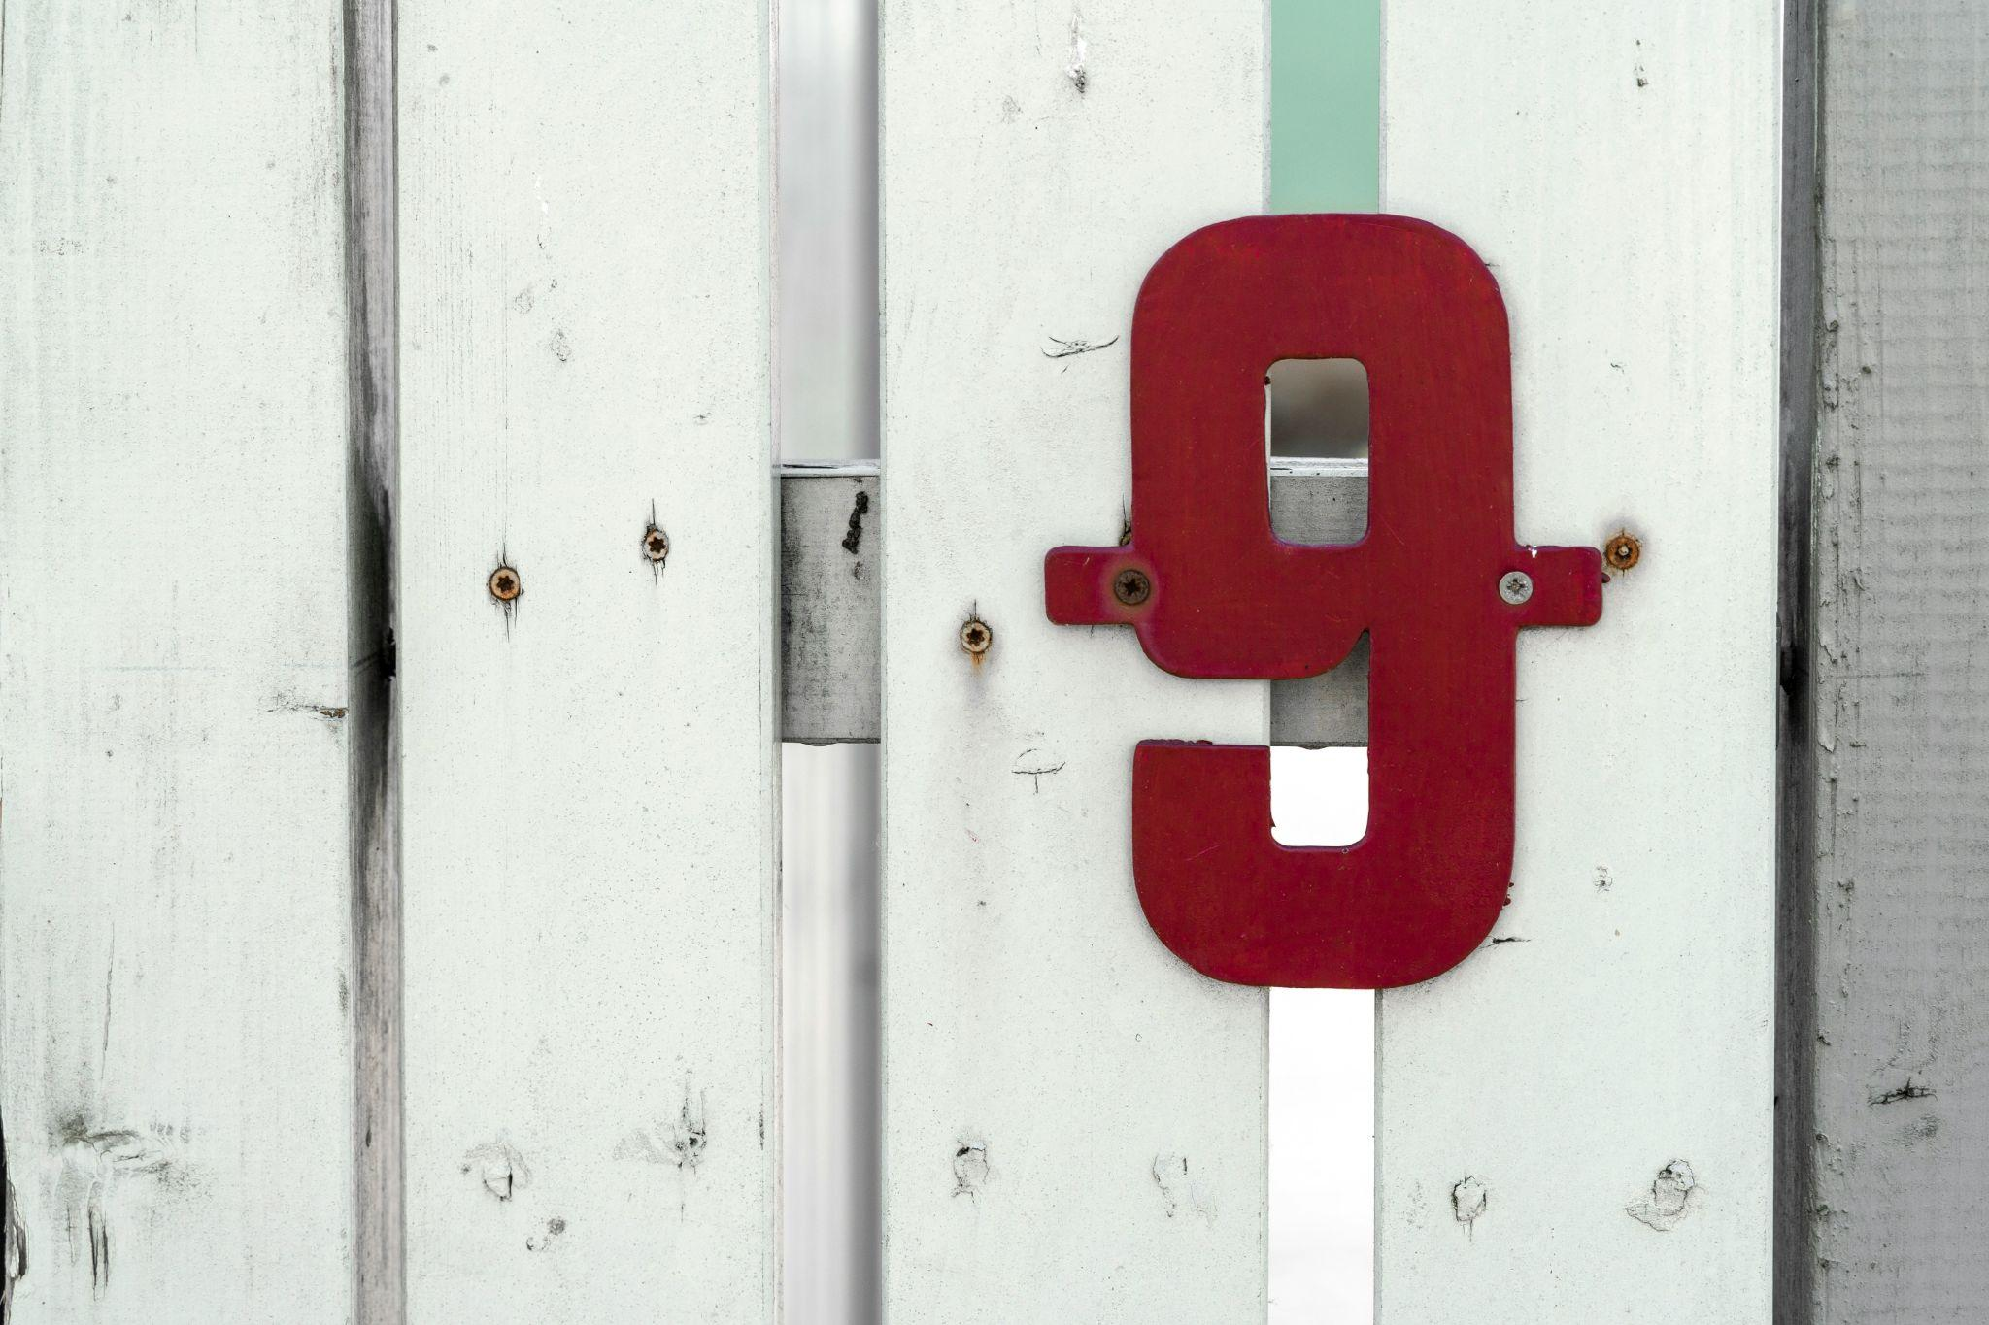
Get some training for staff.

Slide 26
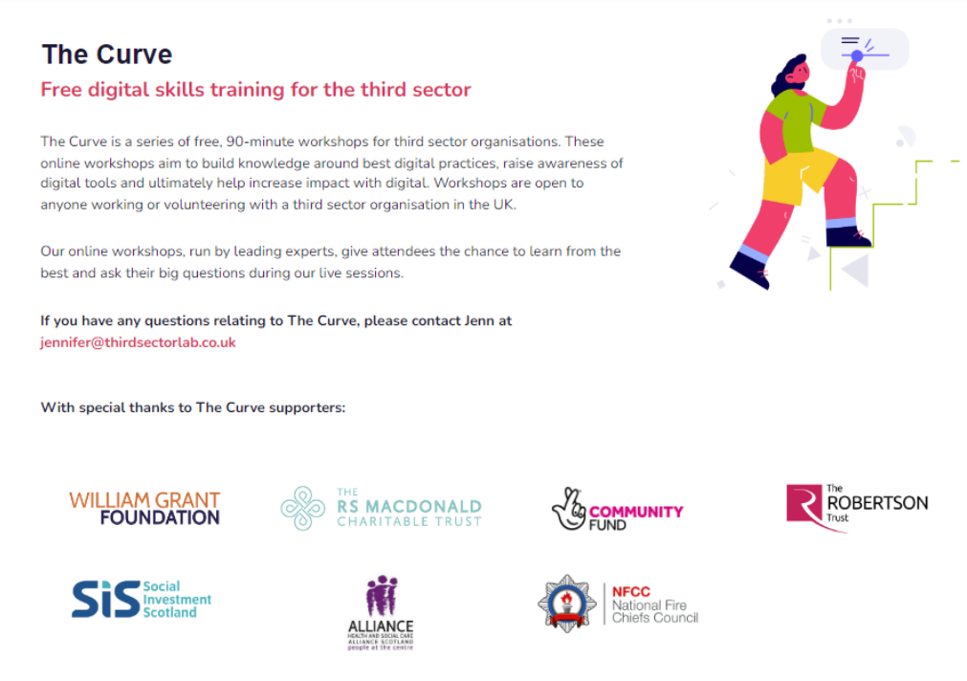
www.thirdsectorlab.co.uk/training

Slide 27
Get someone on your board who cares about this stuff.

Slide 28
User-research Hannah Wallwork has helped transform Cycling Without Age England’s approach to user-centred design.
Digital Trustees - Find your own Hannah

Slide 29
How are services ‘designed’ in your organisation right now?
Think about how you do/don’t currently understand user needs, co-create, test ideas and make decisions.

Slide 30
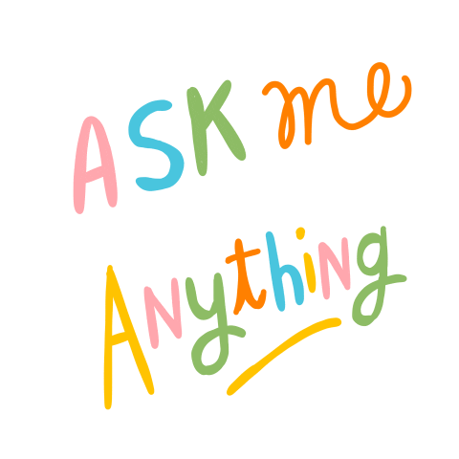
Any questions?
Ross McCulloch
www.thirdsectorlab.co.uk
ross@thirdsectorlab.co.uk
075151 62 686
🐦 @ThirdSectorLab

