Slide 1
Strategic business
Planning is fun

Slide 2
“You can’t solve a problem in the same state it was created”
Albert Einstein

Slide 6
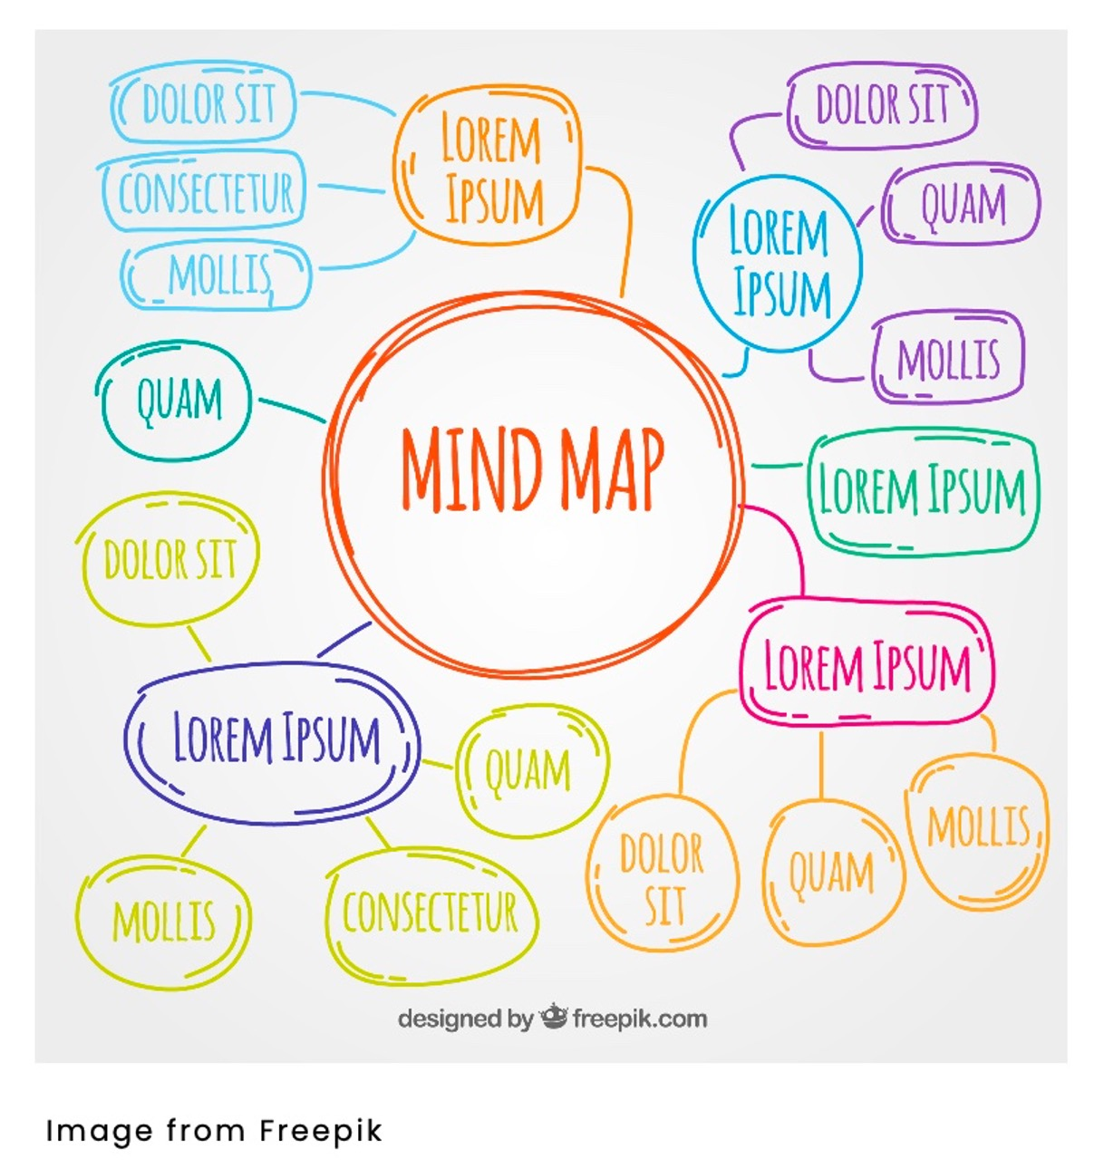

Slide 10
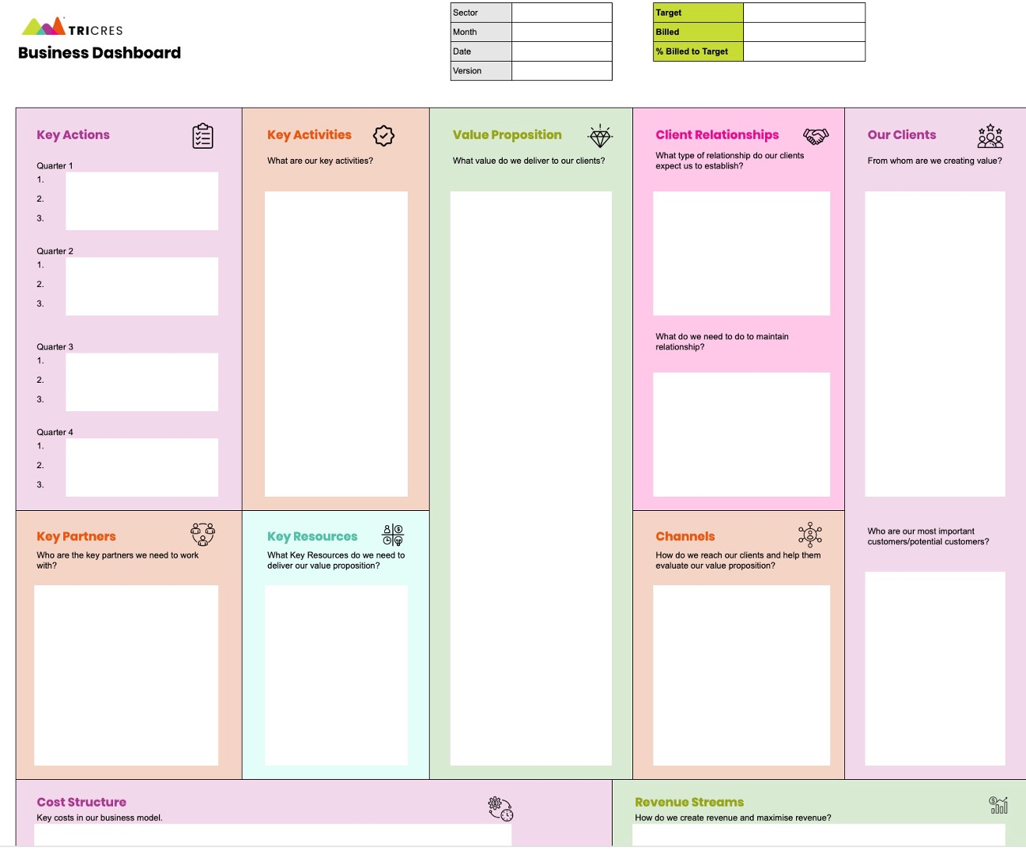

Slide 11
Any questions?
Track me down on LinkedIn
https://www.linkedin.com/in/rebeccabonnington/

