Slide 1
UK GDPR: The Essentials
Talking through the essentials of data protection law
Dominique Mitchell,
Senior Policy Officer – Scotland Office

Slide 2
Firstly, let’s hear from some of you:
Name, role, organisation
What kind of individuals do you support/work with?
A few words, or one word, about data protection and your organisation

Slide 3
Today we’re going to talk about:
Introduction to the ICO – who we are and what we do
Key definitions (controller, processor, personal data)
Principles
Lawful bases
Personal data breach
Individual’s information rights
Data sharing
ICO and SCVO resources

Slide 4
Key definitions:
determines the purposes and means of processing personal data
Controller
Processor
responsible for processing personal data on behalf of a controller
Personal data
information that relates to an identified or identifiable living individual… (the data subject) Identified directly or indirectly… …by reference to an identifier (Name, number, IP address.)

Slide 5
Special categories of data need extra care
Race or ethnicity
Political opinions
Religious or philosophical beliefs
Trade union membership
Physical or mental health
Sexual life or orientation
Genetic or biometric
Financial data?
Notes:
JB

Slide 6
Criminal offence data – needs extra care
This Photo by Unknown Author is licensed under CC BY-SA-NC

Slide 7
Do you store, share, or collect children’s data?

Slide 8
The seven principles that underpin data protection law
Lawful, fair, and transparent
Purpose limitation
Data minimisation
Accuracy
Retention
Security
Accountability
Notes:
MF

Slide 9
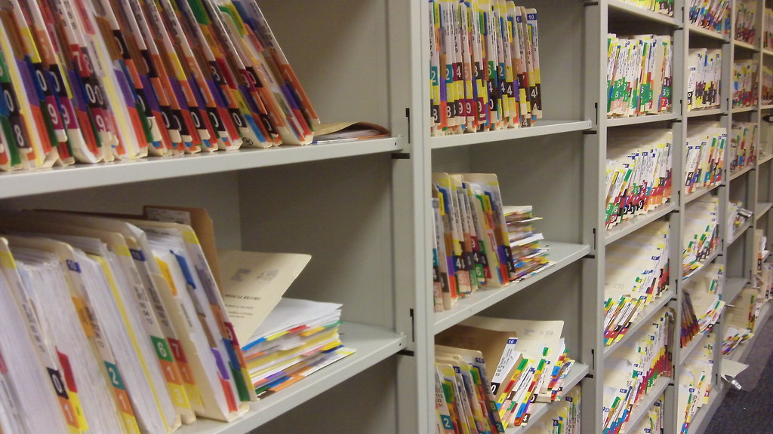
Storage Limitation principle

Slide 10
Lawful basis for processing data
Consent
Or where necessary for:
Contract
A legal obligation
vital interest
Public task
Legitimate interests
Notes:
MF

Slide 11
Still not sure? Use our tool…

Slide 12
personal data breach
Notes:
JB

Slide 13
Individuals' rights The right of access The right to object The right to be informed The right to rectification The right to erasure The right to restrict processing The right to data portability Rights related to automated decision-making and profiling
Notes:
JB

Slide 14
Does your organisation share data with others?

Slide 15
What resources do we have to help you?
SME hub contains advice, guidance, self service tool kits, quick start guides, templates etc
Subject access request self serve
Check if you need to report a breach to us
72 hours - how to respond to a personal data breach
Generate your own privacy notice

Slide 16
If in doubt, give us a shout!
Use our website – it is full of resources!
2. Call the ICO helpline on 0303 123 1113
3. Email scotland@ico.org.uk

Slide 17
Keep in touch
Scotland Office:
6th floor, Quartermile One 15 Lauriston Pl Edinburgh EH3 9EP
T: 0303 123 1115 E: scotland@ico.org.uk
Subscribe to our e-newsletter at www.ico.org.uk or find us on…
/iconews
@iconews

