Slide 2
Democratic Finance Scotland
A programme of support for community led organisations to explore alternative methods of raising finance and funding.
Particularly money that is locally sourced.
Ensuring communities have the
financial control and the democratic power
to take ownership of important community assets
and run democratic community led businesses

Slide 3
Why is Democratic Finance needed?
Grant dependency too high
Social Investment loans not always best fit
Match funding often required
Flexible, non-capital, funding required
Builds democratic, robust enterprises

Slide 4
What are these alternative methods?
Locally sourced money from community members and local organisations:
Community shares
Community bonds
Grassroots legacy giving
Local philanthropy
Donation based crowdfunding
One-off community lotteries
Common Good Funds

Slide 6
Our support is fully funded and in two stages
Early Stage
Exploring what democratic finance sources are the best fit for your community
2. In Depth Development
Community engagement and consultation
Governance expertise and training
Business planning and financial modelling
Marketing and PR incl. £5k Micro Grant available

Slide 7
Additional Programme Support
Community-led opportunities from renewable energy developments
Community ownership of renewables – 100% and shared ownership
Fair distribution and good governance of Community Benefit Funds

Slide 8
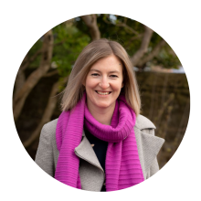
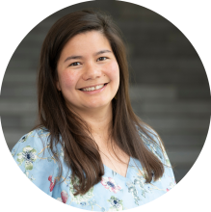
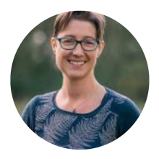
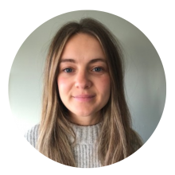
DTAS’ Democratic Finance Team
Morven Lyon – Head of Democratic Finance
Isla McCulloch– Democratic Finance Development Officer
Specialism in community shares and Community Benefit Societies
Pamela Barnes– Democratic Finance Development Officer
Specialism in community engagement and comms
Katie Little-Sadler – Democratic Finance Development Officer
Specialism in community engagement and comms
Laura Bedford – Democratic Finance Development Officer
Specialism in good governance and Development Trust approach

Slide 9
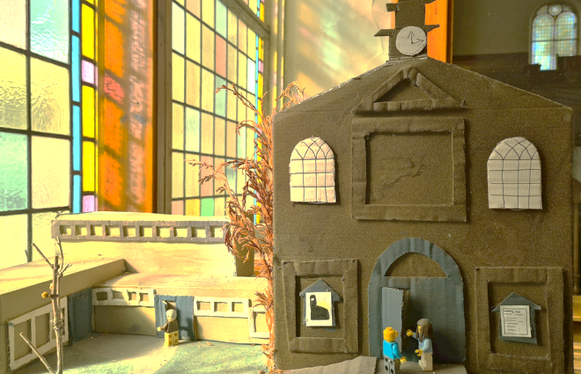
Action Porty – Bellfield Church
£200,000 raised through community shares
Match funded by £450,000 Community Ownership Fund and £100,000 Acorns 2 Trees
Community Benefit Society structure – democratic and community led
£25 minimum residents
£50 minimum non-residents
Investment from local organisations
2% interest and withdrawals from 2029
Enterprising business – room and event hire
One member one vote
Amazing community engagement campaign

Slide 10
Get in Touch!
www.democraticfinance.scot
info@democraticfinance.scot
morven@dtascot.org.uk

