Slide 1
Energy Baskets with

Slide 2
Let’s talk about Energy Baskets: a smart way to reduce energy costs while supporting green energy.
Firstly, we purchase renewable energy from suppliers like Ecotricity, which offers 100% green energy. But rather than buying small amounts, we purchase in bulk chunks known as 'clips.
Each clip is 10 GWh, and if we buy several clips at once, we get a bulk discount. The energy from each clip is used over 365 days, with a usage tolerance of plus or minus 20%.

Slide 3
Why does this matter?
When we combine the energy needs of multiple charities and non-profit organisations, especially those with shared environmental goals, we gain access to better tariffs.
The more people we group, the more clips we can buy and the more flexibility we get with how that energy is used.

Slide 4
Survey Results

Slide 5
We had responses from a broad mix of charities.
78 charities from SCVO
50 from workshops we have presented at between Jan 2025 and April 2025
557 Village Halls across Scotland, England and Wales
Nearly 60% are grassroots organisations with annual incomes under £100k

Slide 6
When we asked what the main barriers are to increasing efficiency and achieving Net zero, the biggest challenge was rising energy prices, which is affecting nearly 80% of respondents!
And when we asked what Charities need the most, our top 3 responses were:
renewable solutions,
help finding the best energy deals,
and access to a group purchasing scheme.
That’s nearly 50% saying they’d actively welcome the idea of joining forces to cut costs through collective procurement.

Slide 7
Which brings us to why we are here today.
A collective purchasing basket can help charities unlock significant value by lowering energy bills, simplifying the process, and leveraging group buying power to negotiate better deals.
It’s also a way to support long-term sustainability by aligning supply contracts with greener options and Net-Zero goals.

Slide 8
Other benefits
Access to group purchasing of:
EV Charging
Broadband services
Energy management software
Access to Utility Aids Charity Foundation

Slide 9
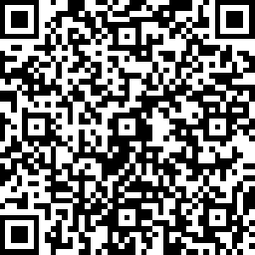
If you would like to be involved with the collective purchasing scheme or just want to find out more information, please fill in your details here.
Register your interest

