Slide 1
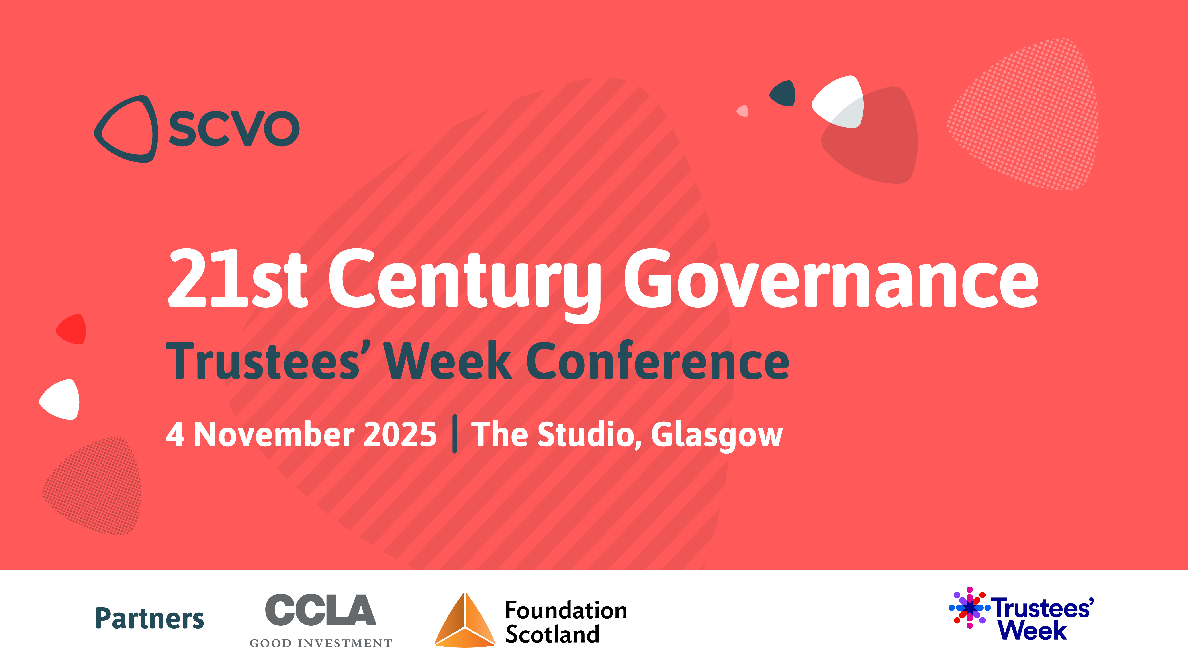

Slide 2


Welcome, CCLA
Session 1: Modernising governance
Session 2: Trustee update
Session 3: Strategic planning
Session 4: Board dynamics

Slide 3
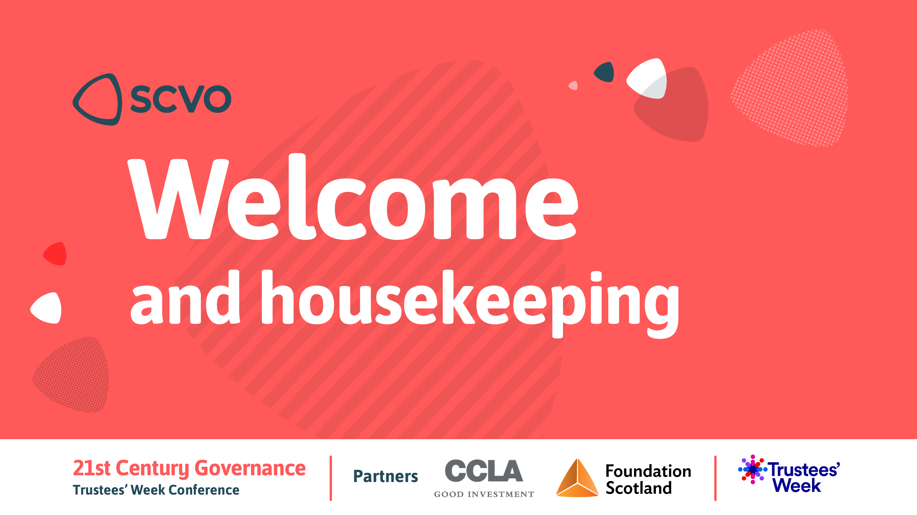
Karin Gallacher, SCVO

Slide 4

Celia Waring, CCLA

Slide 5

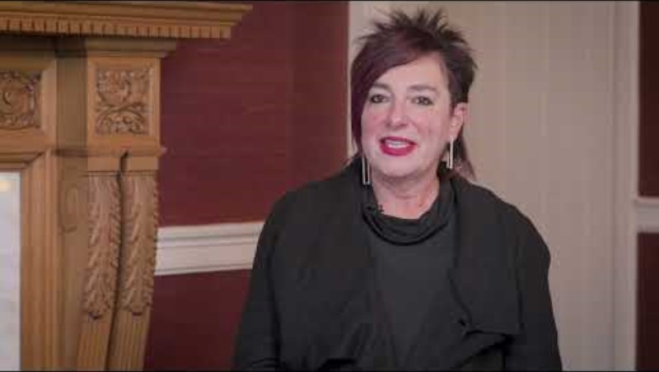

Slide 6
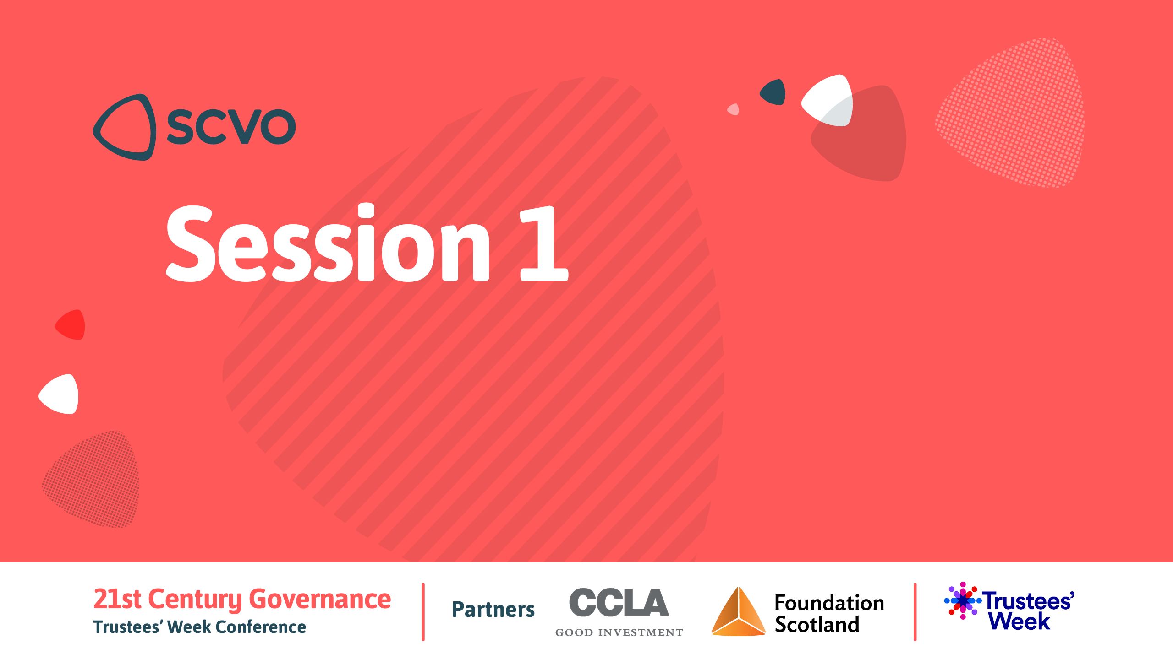
Modernising governance:
What needs to change, and why, to ensure sustainability and success

Slide 7
Modernising governance: panel
Amanjit Uppal, Young Trustees Movement
John Fitzgerald, SCVO
Sean Duffy, The Wise Group
Steff Bell, Foundation Scotland
Chaired by Kenneth Pinkerton, Brodies

Slide 8

Back in 20 minutes….

Slide 9

Trustee update
Rhona Delaney, Anderson Strathern
Steve Kent, OSCR

Slide 10


Changes to charity law
What do they mean for charity trustees?
Steve Kent, Policy Manager
4 November 2025

Slide 11

Key changes to charity law affecting charity trustees
Charities (Regulation and Administration) (Scotland) Act 2023
30 June 2025 Registration of all charity trustees with OSCR commenced
31 August 2025 New rules on automatic trustee disqualification came into effect
early 2026 Trustee names and charity accounts are expected to be published on the Scottish Charity Register

Slide 12
Registration of charity trustees
Trustee name, address and other contact details Date of birth Date of appointment (and termination)
Data processed for OSCR internal use only
Data entered by registered users through OSCR Online portal
Notes:
We anticipate holding a schedule (database) of 160,000 individuals who currently serve as charity trustees of one or more charities in Scotland.
We will also hold information on former trustees (those whose office has terminated) for up to two years.
Data will be processed for OSCR internal purposes only, to verify identity and to enable us to exercise our statutory functions
It will reduce the risk of us losing touch with a charity and enable us to contact trustees more easily if we have important information to share
New ‘manage trustees’ tab is now live when you login to OSCR Online. Details of new trustees can be added and existing entries can be amended by registered users.
Should be done as soon as possible after there are changes
In future, it will also become mandatory to complete/confirm trustee data when completing annual returns
Charities with annual returns due in November / December will be receiving a reminder from us to register trustees
We have now resolved a few early issues with registration (eg corporate trustees, trustees with overseas addresses)
Nb. If you make a duplicate entry in error you cannot remove it. Contact us and we will remove it for you.

Slide 13

Keeping your personal data safe
Annual data protection training for all staff
Regular cybersecurity checks
Strong security from all points of access
All technological devices are encrypted
Multi-factor authentication
Role-based permissions
CyberEssentials Plus accreditation
Notes:
Will trustee data be safe?
Legislation requires us to ensure the ‘Integrity and Confidentiality’ of data. This means that we must process personal data with suitable security to prevent unauthorised access and ensure its safety from accidental loss or damage by ensuring we have sufficient technical safeguards and codes of conduct for our staff in place.
We take security very seriously in OSCR.
All staff take annual Data Protection training.
We have regular cybersecurity checks.
We have strong security covering our systems from all points of access.
Where we have contracts with external suppliers, which means they have access to our data, the responsibilities of OSCR and the suppliers regarding the use and security of data are clearly stated in the contracts.
All our work Laptops, tablets, and mobile phones are encrypted to prevent unauthorised access, particularly if they are lost or stolen.
Access to internal systems is restricted to OSCR staff through multi-factor authentication, and staff are assigned role-based permissions to ensure they can only view data necessary to their role.
To provide further assurance to stakeholders, charities, and trustees, OSCR has also achieved CyberEssentials Plus accreditation from IASME. This accreditation requires OSCR to demonstrate adherence to a range of industry-standard security standards.
OSCR's Privacy Statement can be found HERE.
OSCR’s Data Protection Policy can be found HERE.
OSCR's Cyber Essentials Plus certificate can be found HERE.

Slide 14
Trustee registration – what we’ve found so far
Data received for 7,541 charities
Total trustees recorded
Median age of trustees
Youngest trustee
Oldest trustee
Average time serving as a trustee
Longest time serving
Average trustees per charity
Highest number of trustees
30.4% compliance
48,000
62
16
108
7.78 years
80.9 years
5
256
Notes:
We are encouraged by the level of compliance so far. We are ahead of where we expected to be four months after the new requirement started.
But if you haven’t entered data yet please don’t sit back and wait for our reminders. The sooner the better.
More charities are entering data every day. Here are some of our findings to the end of October – thought you would be interested to see the emerging picture.

Slide 15
Automatic trustee disqualification
SINCE APRIL 2006
SINCE 31 AUGUST 2025
Conviction for offence involving dishonesty
Conviction under bribery legislation
Disqualified as a company director
Conviction under proceeds of crime legislation
Undischarged bankruptcy
Conviction for perverting the course of justice
Protected trust deed
Terrorism or association with proscribed terrorist group
Removed as trustee by the Court
Misconduct or negligence as a public official
Removed as trustee by Charity Commission
Disobedience with an order of Court
Sexual offences subject to notification
Notes:
Guidance on our website including full criteria
Reference to convictions means ‘unspent’.
Importance of charities conducting due diligence when considering trustee appointments.
No single point of reference for charities that will identify all people disqualified. Reliance on self-declaration.
OSCR has updated model trustee declaration form – draw candidate’s attention to the rules
Duty is on individuals not to act while disqualified (an offence) and to declare to the trustees.
Refer to our guidance and, if in doubt, stand down and seek professional advice.

Slide 16
Extension of automatic disqualification
Rules extended to include individuals holding office or employment with senior management functions or those who volunteer with senior management functions
Senior management function means:
Relating to management of a charity
Accountable only to the charity trustees
Either
and
Involving control over money
Accountable only to a senior manager
Accountable only to the charity trustees
Or
and
or
Notes:
Expansion into senior management roles.
Recognises that senior managers (who are typically employees and remunerated for their services) have a pivotal role in the management of charities.
Allows Scottish charity law to achieve broad parity with England, Wales and Northern Ireland.
It is important that an individual disqualified from running a charity in one jurisdiction of the UK cannot participate in the running of a charity in another UK jurisdiction.
OSCR has published guidance on senior management function and how this should be interpreted.

Slide 17
Waiver of disqualification
May be granted by OSCR in exceptional circumstances
Can apply to a charity, type of charity or charities in general
Each case assessed on its own merits taking account what is in the best interests of the charity
Guidance, examples and an application form available on OSCR website
Application must be accompanied by a supporting statement / evidence from the charity trustees
Notes:
Number of people affected is not expected to be high.
Since the new rules commenced OSCRT has received one application for a waiver from an employee with a senior management function. The waiver was granted.

Slide 18
Information about charities on the Register
From early 2026 (pending Parliamentary commencement order)
Charity trustee names (only) published unless OSCR has granted an exemption
Accounts for all charities published unredacted
Trustee names may be excluded from annual reports where an exemption has been granted from publishing names
Notes:
Increasing information about charities on the Register helps to improve public trust and confidence.
Charities are bodies in which the public has a legitimate interest. Knowing who runs charities is important in terms of trustee accountability
Exemptions can be granted when OSCR is satisfied that publishing the name of a person would result in risk to that person’s safety or security of their premises.
Application form for exemption on our website, together with examples of how we are likely to consider different scenarios.
Desire for privacy is not sufficient
Exemption not likely to be granted if information is already in the public domain (eg register of companies, charity’s own website)
OSCR already publishes accounts for larger charities and SCIOs.
In time the Register will hold a historic record of the accounts for the past five reporting periods
Will publish all accounts received after the commencement date – regardless of the financial year to which they relate
Personal information will no longer be redacted.
Onus upon charities to ensure that what they send us is publication-ready.
Take care with including information that identifies individuals other than trustees (beneficiaries, donors). Photos, signatures.
OSCR accepts electronic signatures.
Amended accounts regs will make provision for trustee names to be excluded from the TAR where an exemption from publishing a trustee’s name under section 3(4) has been granted.

Slide 19





What you can do to respond to these changes
Ensure that you know who all your trustees are and collect up to date information on them. Start registering them straight away.
Ensure your annual accounts are prepared to a style and standard you are content to be published. Think carefully about including information that identifies individuals (other than trustees).
Alert your charity trustees or managers to the disqualification rules. Anyone affected must cease to act at once unless a waiver has been granted.
Update your governance materials (eg. induction packs, trustee declarations, due diligence on trustee appointments). Review contracts of employment for senior managers.
Familiarise yourself with all the relevant guidance already on our website.
Keep a watch for OSCR news items and updates as we publish new guidance (links on the next slide)
Notes:
QR codes for the guidance I have been referring to are available for you to scan.

Slide 20






Keep up to date
OSCR Reporter Newsletter
@ScotCharityReg
ScottishCharityRegulator
Scottish Charity Regulator
Scottish Charity Regulator

Slide 21
Legal changes and sectoral round-up
Rhona Delaney, Director
4 November 2025

Slide 22
Other legal changes
The Economic Crime and Corporate Transparency Act 2023
The Data (Use and Access) Act 2025
Disclosure (Scotland) Act 2020
The Digital Markets, Competition and Consumers Act 2024
To be introduced…new Charities Accounts (Scotland) Regulations

Slide 23
Sectoral round-up
Mergers
Changes in legal form
Charity trustee training
Updates to constitutions
FoIs and SARs

Slide 24
Sectoral round-up
Donations – implications of accepting donations from certain funders
International conflict – taking a stance
“Cancel culture” – responding to demands to “cancel”
Disruptive members

Slide 25
Overarching principles
ALWAYS think – does this decision furthers the charitable purposes of your charity?
ALWAYS ask – are you taking a decision which you consider (in good faith) is in the best interests of your charity?
Have you taken account of all relevant factors? For example:
The impact on your staff/volunteers of the decision;
The impact on your key stakeholders;
The impact on relations with those you have contractual relationships with e.g. funders, suppliers;
The reputational impact;

Slide 26
Overarching principles contd.
Have you taken account of all relevant factors (contd)? For example:
The extent of your powers, including legal restrictions;
Have you done your due diligence?
Financial impact;
Is the decision reasonable?
Have conflicts of interest been managed?
Have charity trustees been able to put personal motives and considerations to one side?
Has there been sufficient discussion-time allowed?
Top tip: pause and take time, where possible, without knee-jerk reactions.

Slide 27
Questions?

Slide 28


Rhona Delaney
Rhona.Delaney@andersonstrathern.co.uk

Slide 29
Back in 50 minutes….

Slide 30

Strategic planning and future proofing
Philippa Bonella, Consultant
David McNeill, SCVO

Slide 31

The role of charity trustees in planning
“ As charity trustees, you should:
Review and update the charity’s plans regularly.
Agree financial budgets and monitor financial performance.
Review the performance of the charity and, where necessary, agree steps to improve performance.
Regularly compare what the charity proposes to do with the governing document to see if anything needs to be changed or updated.”
https://www.oscr.org.uk/media/3621/v10_guidance-and-go-practice-for-charity-trustees.pdf (p12)

Slide 32

Strategic plan, business plan, operational plan
A strategic plan gives your charity clear goals to drive its work (often 3-5 years)
A business plan shows how you will find the resources to deliver
An operational plan tells your staff what they need to do to deliver the goals (usually 1 year)
You don’t need all of them written down separately! But you do need to think about goals, resourcing and delivery.

Slide 33
What is the Board’s role in the process?
Planner
Champion
Critical friend
Protector of mission and values
Voice of beneficiaries/users
Setting limits
Problem solver
Doing it all at your desk
Signing off the final draft
Selling it

Slide 34
Good strategic questions for trustees
Process – who is driving it and what is our role?
Direction – do we still need to exist? If yes, how do we evolve?
Culture and values – are these clear and agreed? Do we live them internally?
Involvement – who is being involved in the planning and the delivery? Who’s missing?
Delivery – what’s changing and how? Do we have the resources we need?
Measuring success – how will we know we’ve made a difference?
Review – how often will we review the plan and how will we change it?

Slide 35
Planning to plan
8
Design process
Sell and listen, adapt
Map context and listen to users
Reflect and revise
Final draft
Reflect
Implementation
Resourcing
Future priorities Success measures
Draft strategy

Slide 36
Navigating uncertainty
No strategy can be set in stone
No strategy will be completely implemented, ever!
You will always see things to do differently/better next time
What approach will best help you and your board?
Long term vision (compass point to guide you)
Different scenarios (good, middling, bad)
Short term practical targets
Focus on the shifts you want to see happen
Setting – and diarising – regular reviews

Slide 37
Resources – strategic planning
New Philanthropy Capital – Strategy for impact
Strategic planning: A Toolkit for Small NGOs
Tools for community-led planning with examples
CASS Business School – Board involvement in strategy and planning

Slide 38

Contact me
Philippa Bonella 07827 290482 philippa.bonella@gmail.com
Find me on LinkedIn https://www.linkedin.com/in/philippa-bonella-55b06749

Slide 39
SCVO Information Service
Website https://scvo.scot/
enquiries@scvo.scot
Freephone 0800 169 0022
And your local Third Sector Interface https://tsi.scot/

Slide 41
Strategic planning and future Proofing
Philippa Bonella, Consultant
David McNeill, SCVO

Slide 42



A perfect storm
Financial challenges
Increased demand on services
Impact of permacrisis?

Slide 43
It’s a challenging context
In Jan/Feb 2025
81% of organisations reported financial-related challenges, an increase of 10% since spring 2023.
11% stopped delivering one or more strands of work.
11% made redundancies
20% cancelled or postponed staff recruitment
Volunteer shortages one of top 3 problems

Slide 44
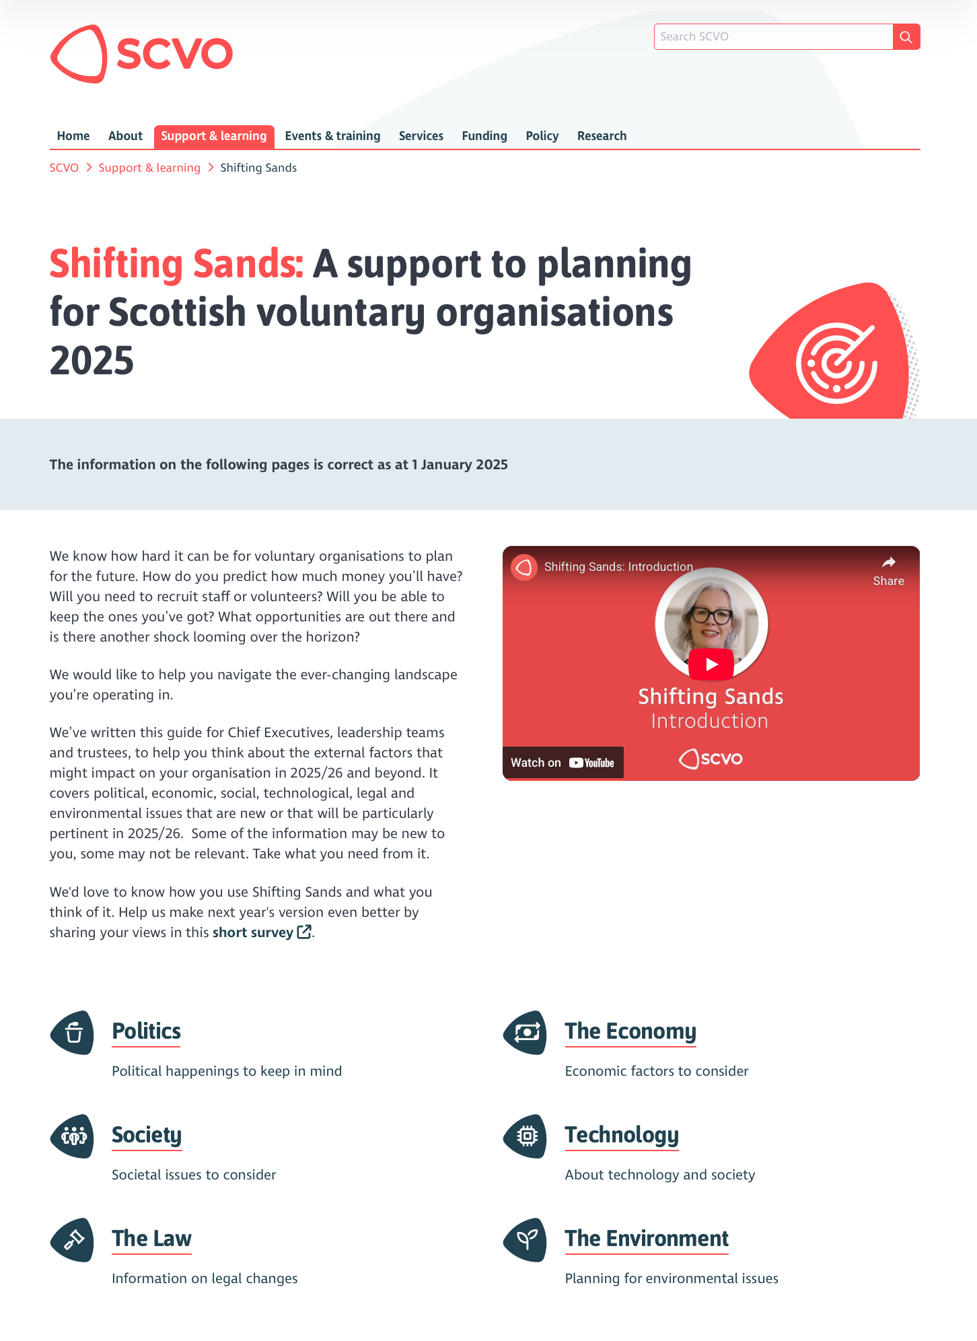

Slide 45
Economic context
Global issues with local impact: Trump, Brexit, war, rocky economic recovery
Cost of living crisis for people
Inflation and rising costs for organisations
Wages not keeping up with inflation – does the sector ‘walk the talk’ on fair work?
Social enterprise and ‘responsible business’
The enduring issues about fair funding for the sector

Slide 46
Social context
An ageing population
Health and social care challenges
Typical childhood and adolescence disrupted by the pandemic
Changes in post pandemic work, shopping, leisure, travel, communities and routines… the impact on the people you work with as well as your workforce and volunteers
Populism / polarisation / culture wars / mistrust / alienation

Slide 47
Political context
Sector is highly regarded and influences policy
Challenge is in implementation of policy
Commitment to better funding relationships with the sector… but is it just warm words?
Acknowledgement that Government ‘can’t do everything’ – more focus on tackling poverty
More money to individuals through social security (+/-)
Significant implications of Council budget cuts
2026 elections and the rise of Reform

Slide 48
Technological context
Changing consumer behaviour (and impact on towns) and cashless society
Higher expectations of services
Access to information, advice and support – starts online
Social media – a force for good or bad?
AI opportunities and risk (FOMO is not a strategy)
Pandemic rapidly accelerated digital adaptation in the sector – but what will stick?
Cyber threats, low resilience (only ~19% have plans)
Digital exclusion still persists

Slide 49
Legal context
Charity regulation changes
Employment Rights Bill
Disclosure

Slide 50
Environmental context
Climate impacts on communities
New regulation (e.g. Heat in Buildings Bill)
54% think climate will have little/no impact… are we under-prepared?

Slide 51
Check out scvo.scot/support/shifting-sands
Join us as a member if you’re not already!

Slide 52
Back in 20 minutes….

Slide 53
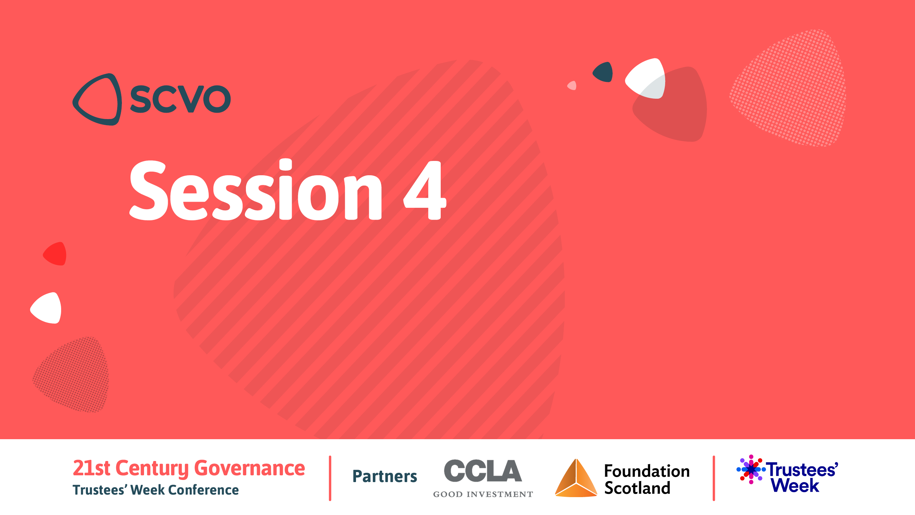

Board dynamics

Slide 54
Board dynamics: panel
Brian Cavanagh
Florence Garabedian
Graham Boyack
Chaired by Ann Pike

Slide 55


