Slide 1
Ilse Mackinnon, SCVO Research Officer
Understanding Village Halls Insights, trends and current issues

Slide 2
What I’ll focus on this morning:
Overview of village halls in Scotland:
    size, shape, context
The current voluntary sector financial picture
Current issues for the sector
Q & A

Slide 3
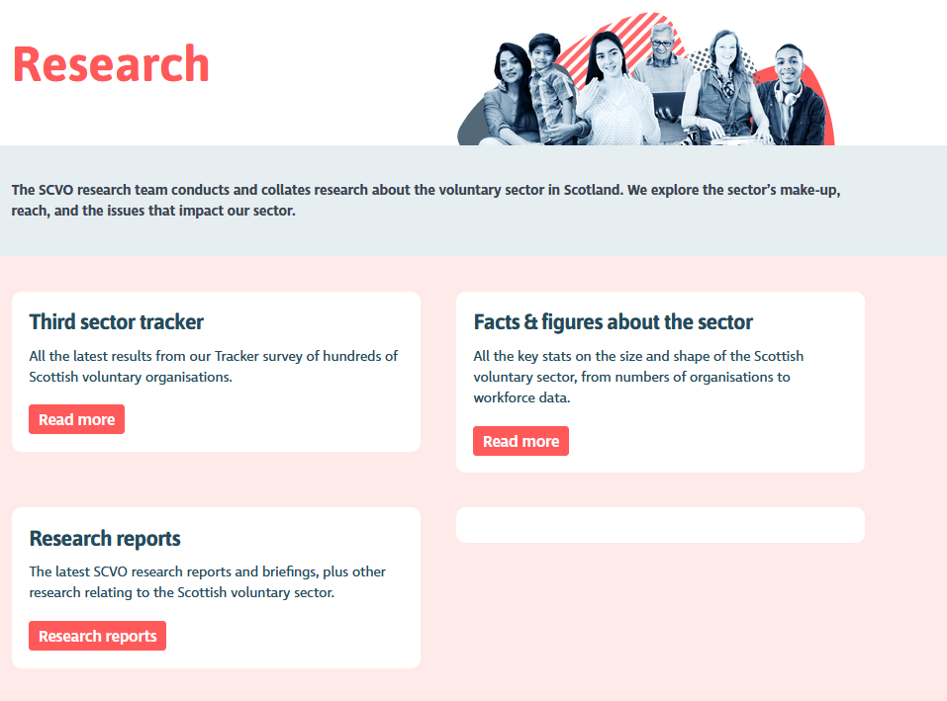
https://scvo.scot/research

Slide 4
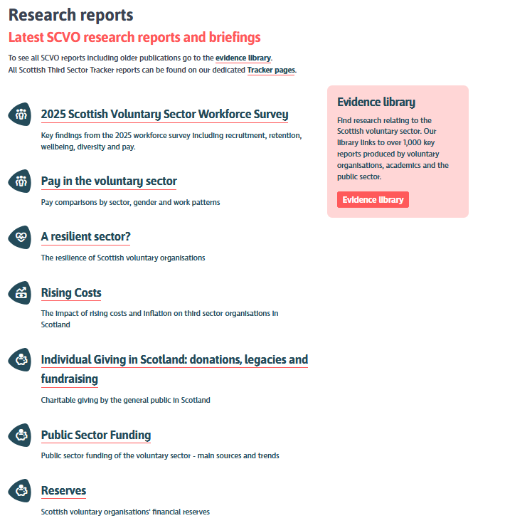

Slide 5
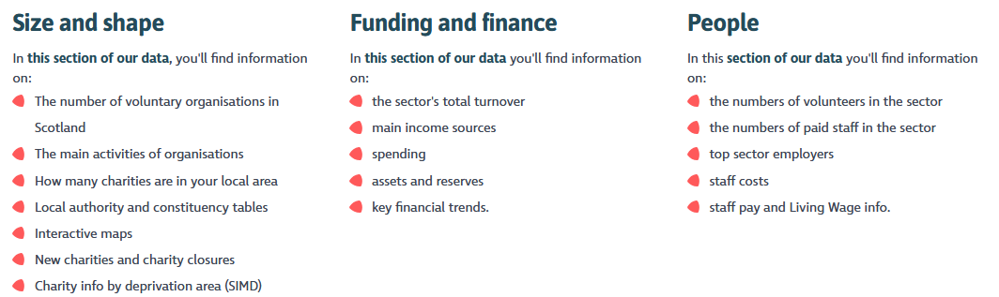
SCVO State of the Sector stats 2026
You can also head to our About the Sector page which gives an overview of the sector including key features, facts and statistics.

Slide 6
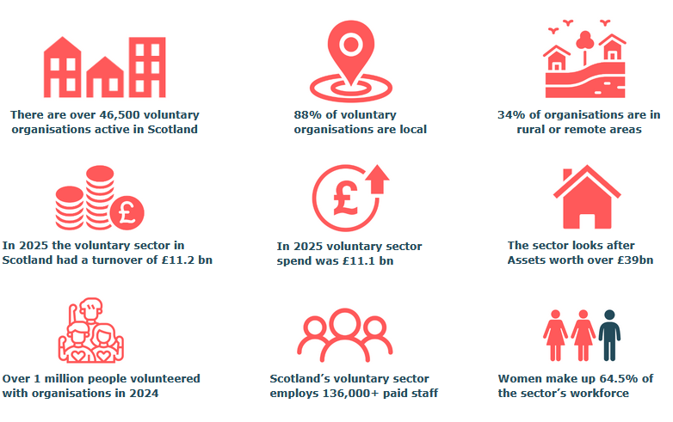

Slide 7
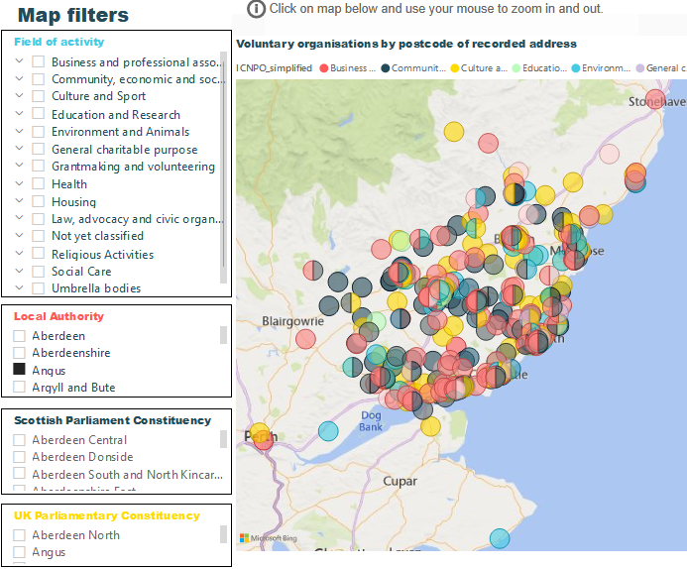
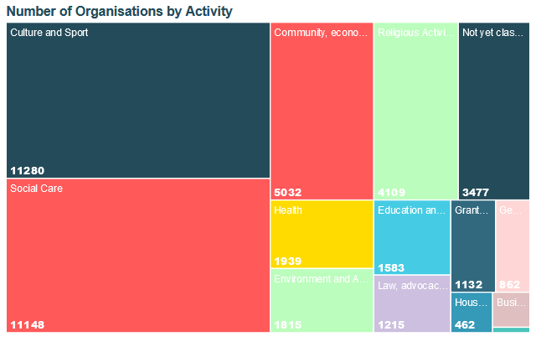
Field of work based on the ICNPO (International Classification of non-profit organisations)
Notes:
Here I’ve got a couple of screenshots that show the types of info in the Sector Stats
So here we’ve got a treemap of the numbers of organisations by field of activity or sub-sector
You can then drill down to get more specific data, or filter on other data like income or staffing numbers or constituency
On the right you can see we’ve got a map so users can search by local authority area, Scottish Parliament constituency, or area of activity – so for example people can look for village halls in the Highlands, or organisations working with Children & Families in Edinburgh., or look at charities by Scottish Index of Deprivation areas

Slide 8
Village halls in Scotland
Size & shape

Slide 9
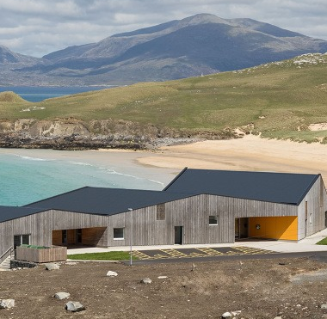
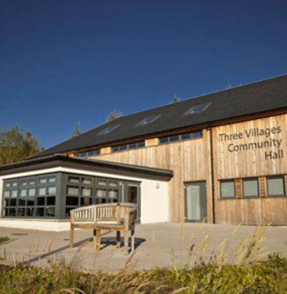
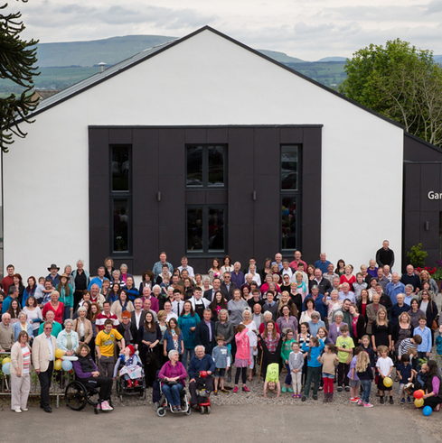

Notes:
Full disclosure – I’m a massive fan of village halls! I know you shouldn’t have favourites but the first research report I did at SCVO was on village halls almost 25 years ago
Interesting report because as at that time village halls were seeing a bit of an increase in recognition in terms of the huge role they play as local community hubs and were starting to see investment from funders like the Lottery helping communities build some amazing spaces or give tired old buildings a make-over and really diversifying the types of activities being offered.
I now can’t go to a town in Scotland now without clocking the local village hall

Slide 10
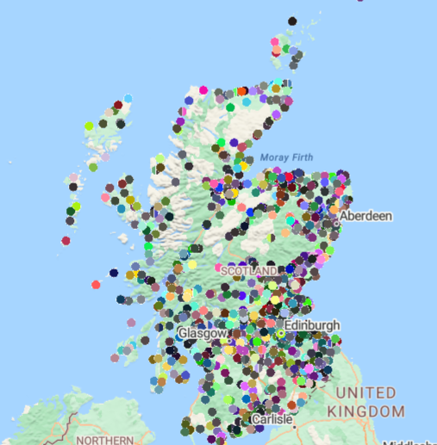
1,422 village halls and community centres across Scotland
1,122 (80%) are registered charities
Doesn’t include hundreds of other community facilities e.g. sports hubs, arts spaces, heritage centres, cultural centres (but many spaces multi-purpose)

Slide 11
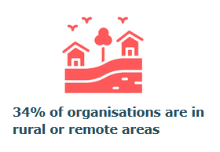
Village halls in Scotland: urban/rural split
467 halls are in urban or semi-urban areas
922 halls are in rural areas
66% of halls rural
versus
34% of wider sector

Slide 12
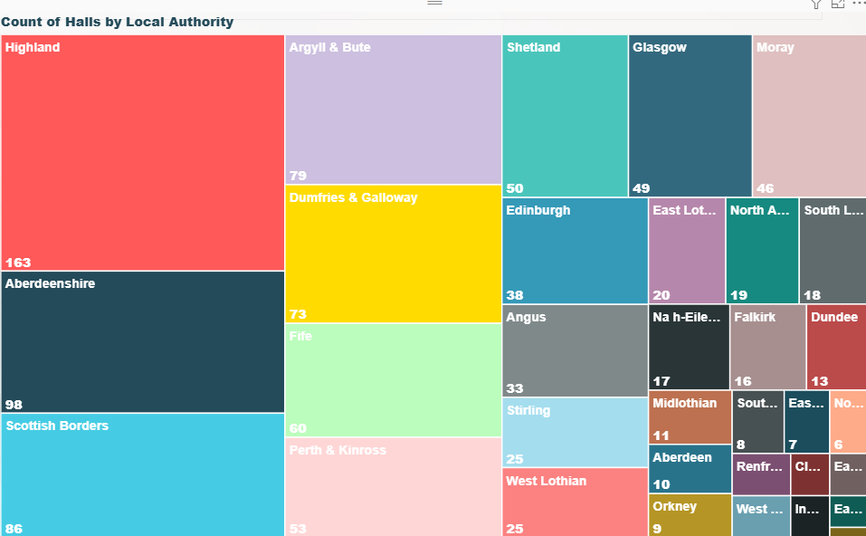
Eight primarily very rural local authority areas account for over half the halls in Scotland.
Community buildings in cities and urban areas also account for a large portion.
In some areas, halls are run by voluntary management committees, but the building is owned by the Local Authority.
In a few areas halls are mainly owned and run by the local authority.

Slide 13
Village halls in Scotland: legal form
Halls are slightly more likely to be SCIOs or Trusts.

Slide 14
Village halls in Scotland: legal forms
Dramatic increase in the use of SCIOs in recent years. SCIO is ideal for smaller orgs managing property, legal contracts, insurance, employing staff etc

Slide 15
Village halls in Scotland: by age
16% of village halls became charities over 50 years ago
42% were registered between 1975 and 2009
43% - over 2/5ths - registered since 2010
Majority of halls registered since 2010 were formerly small unincorporated associations, but also lots of conversions to SCIOs.
BUT!
‘Year Registered’ doesn’t tell us the age of the building - lots of old halls have only recently become charities, and many older charities now have brand new buildings.
Date hall was registered as a charity (data source: OSCR)

Slide 16
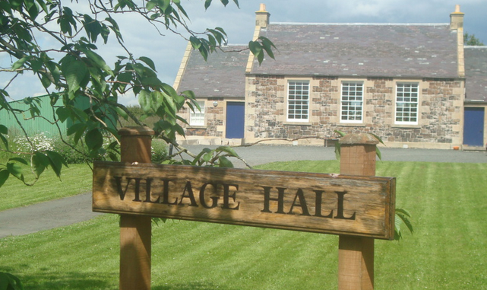
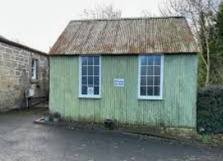
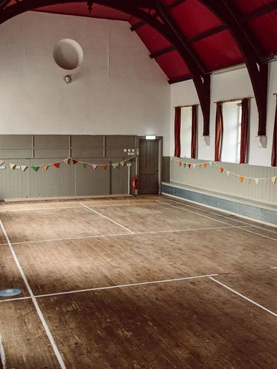
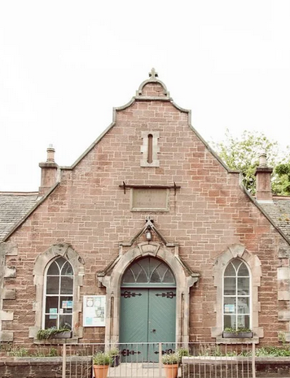
“over two-thirds of those surveyed are more than 50 years old and require improvements to make them either “fit for purpose” and/or to comply with legislation.”
“main source of fuel for over two-thirds of village halls is electricity, with only a minority having renewable energy installations and less than half with any energy conservation measures.”
Scotland's Rural Village Halls: Present And Future Sarah Skerratt, Scottish Rural College, 2009
Notes:
In 2009
So lots of lovely old halls, lots of amazing new eco-friendly architectural gems – and a bunch of halls sitting in the middle that could maybe do with a wee bit of investment and TLC

Slide 17
Village halls in Scotland
Financial picture

Slide 18


Voluntary sector in Scotland: financial picture
Sector Income 2025: £11.2 bn
Scottish charities: £ 9.5 bn
Sector spend 2025: £11.1 bn
Scottish charities spend: £ 9.3 bn
Large charities with incomes over £1m (e.g. housing associations and large social care providers) make up only 5% of charities, but these 972 charities account for over 80% of the sector's annual income.

Slide 19
Village halls in Scotland: financial picture
No of halls in Deficit/surplus 2025
Surplus | 552
Deficit | 433
Breakeven | 18

Slide 20
Village halls in Scotland: financial picture
Village halls combined income in 2025 = £58 m
Income Band | No. of Halls | Sum of Income | Sum of Expenditure
1. Micro: Under £10k | 275 | £1 m | £2 m
2. Small: £10k - £100k | 582 | £19 m | £19 m
3. Medium: £100k - £1m | 122 | £29 m | £26 m
4. Large: £1m - £10m | 4 | £8 m | £7 m
0: £nil | 46 | £0 m | £0 m
New charities / no data | 93
Total | 1,122 | £58 m | £53 m
Village halls combined spend in 2025 = £53 m
Village halls tend to be ‘asset-rich, cash-poor’
The average village hall looks after assets worth over £200k – this is mostly in the form of tangible fixed assets i.e. the building, and mostly in the form of restricted funds.

Slide 21
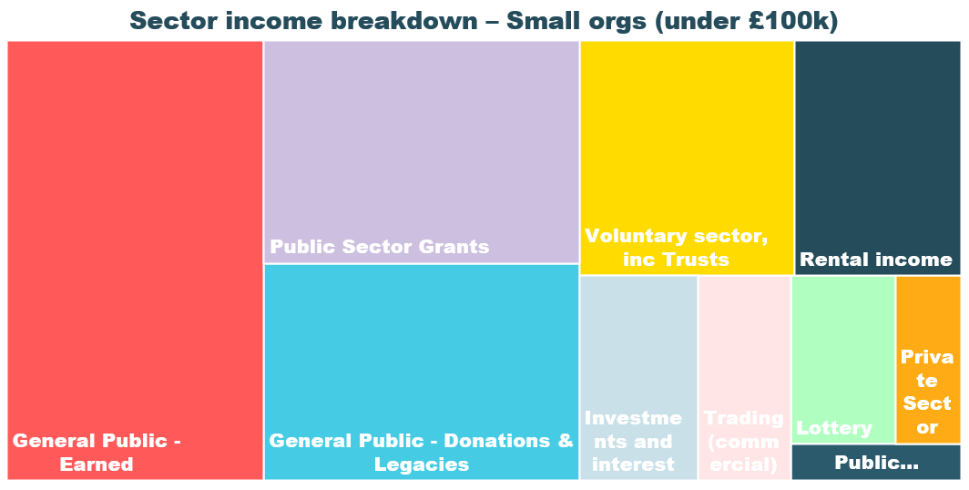
Charities in Scotland: financial picture

Slide 22
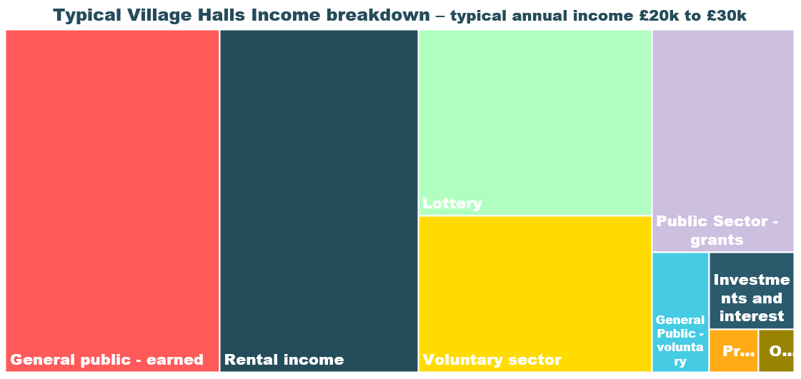
Village halls in Scotland: financial picture

Slide 23
Village halls in Scotland
Current funding challenges

Slide 24
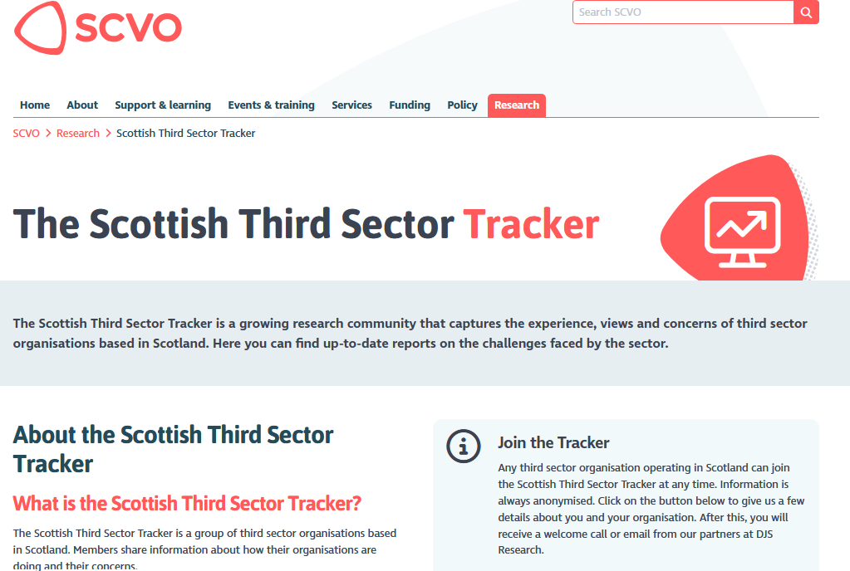
https://scvo.scot/research/scottish-third-sector-tracker
Tracker data for Spring 2026 will be available end of June 2026

Slide 25



Third Sector Tracker: top challenges Autumn 2025
37%
concerned about rising costs
2025: 49%
40%
report difficulties fundraising
2025: 44%
32%
financial or cash flow constraints
2025: 33%
42%
Volunteer shortages
2025: 32%
Only 5% of Tracker panel organisations cited no challenges

Slide 26
Tracker: top three challenges in Autumn 2025

Slide 27
Village Halls in Scotland: funding challenges

Slide 28
Village halls in Scotland
People: staff, trustees, volunteers

Slide 29
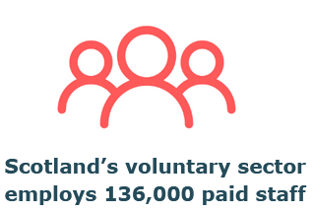

Paid staff
The voluntary sector employs 5% of all Scotland’s employees - more people than both the police and teaching professions in Scotland combined.
1,150
Village halls and community centres employ 1,179 paid staff

Slide 30
Volunteers and Trustees
Village halls and community centres supported by
6,985 trustees
6 to 7 trustees on average

Slide 31
Volunteers and Trustees: current challenges

Slide 32
Village halls in Scotland
Future plans

Slide 33
Future plans: expectations for next year

Slide 34
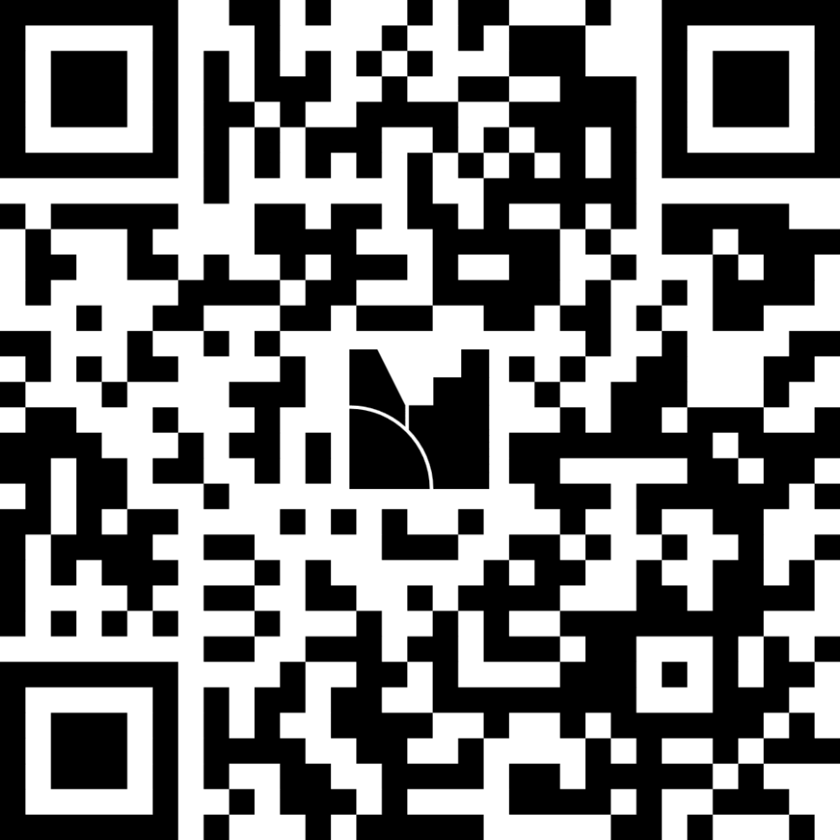
Q & A
A couple of quick questions for you first!

Slide 35
Q & A

